Slide 1
How to Train Your Model
with Project Refinery
Matt Jezyk
Tesla (formerly Autodesk)

Slide 2
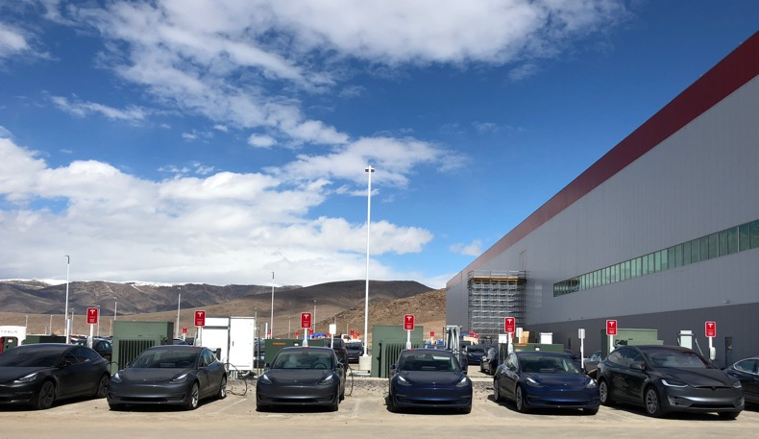
Matt Jezyk
Senior Staff Software Engineer, Tesla
Former Senior Engineering Manager, AEC Generative Design, Autodesk

Slide 3
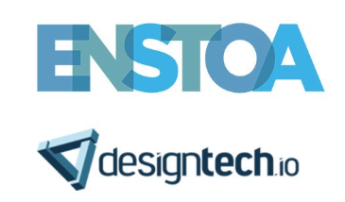
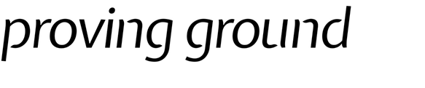

A SPECIAL THANKS TO:

Slide 4
American Institute of Architects (AIA) Continuing Education Services (CES)
For AIA accredited sessions only
Credit(s) earned on completion of this course will be reported to AIA CES for AIA members. Certificates of Completion for both AIA members and non-AIA members are available upon request.
This course is registered with AIA CES for continuing professional education. As such, it does not include content that may be deemed or construed to be an approval or endorsement by the AIA of any material of construction or any method or manner of handling, using, distributing, or dealing in any material or product.
___________________________________________
Questions related to specific materials, methods, and services will be addressed at the conclusion of this presentation.

Slide 5
Session Description
AIA Provider: RTC Events Management LLC Course Number: AIADBW 356
Course Date: July 18, 2019
Creating parametric options is easier than ever, but creating 'good' options is still quite hard. Creating good design options starts by asking the right questions, and then by embedding your custom design logic into code. We will teach you how to code 'Evaluators' and train your model using Project Refinery.
Learning Objectives
At the end of this session, participants will be able to:
1. Frame a design problem in terms of goals and constraints
2. Learn how to write psuedocode to help define the logic before writing final code
3. Develop new custom code in multiple programming languages (Dynamo, DesignScript, Python, and C#)
4. Test the custom logic in a larger generative workflow

Slide 6
HOW TO USE GENERATIVE DESIGN TOOLS TO ADVANCE ARCHITECTURAL DESIGN PROCESSES.
Notes:
This slide can be used to highlight one or two sentences that tie into the topic that you’re presenting on.
For example, if you have an impactful quote or idea that you would like to share, this would be the ideal place to include this message.
Messaging must always be in ALL CAPS to tie into the style and theme.

Slide 7
Overview
WHY?
HOW: How to define goals and metrics
HOW: Evaluator Examples
Hill Climbing – What’s an Objective Function?
Massing Study – Real-World Goals Made Into Evaluators
Solar Analysis – Using Simulation Results
Desk Layout – More Evaluators
Questions

Slide 8
Example files are all Open Source!
The examples for this class:
https://github.com/tatlin/BiLT_NA_2019_How_To_Train_Your_Model
Refinery Primer:
https://refineryprimer.dynamobim.org/
https://github.com/DynamoDS/RefineryPrimer
Refinery Toolkit Dynamo Package and Examples Files:
https://github.com/DynamoDS/RefineryToolkits
Thank You To Our Partners:
DesignTech/ENSTOA, ProvingGround, and Autodesk Research

Slide 9
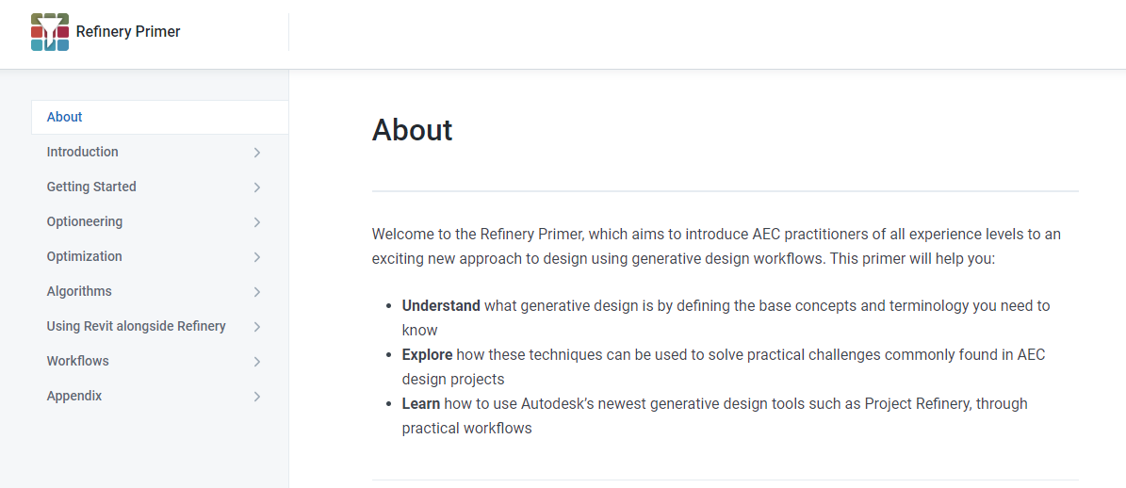

Slide 10
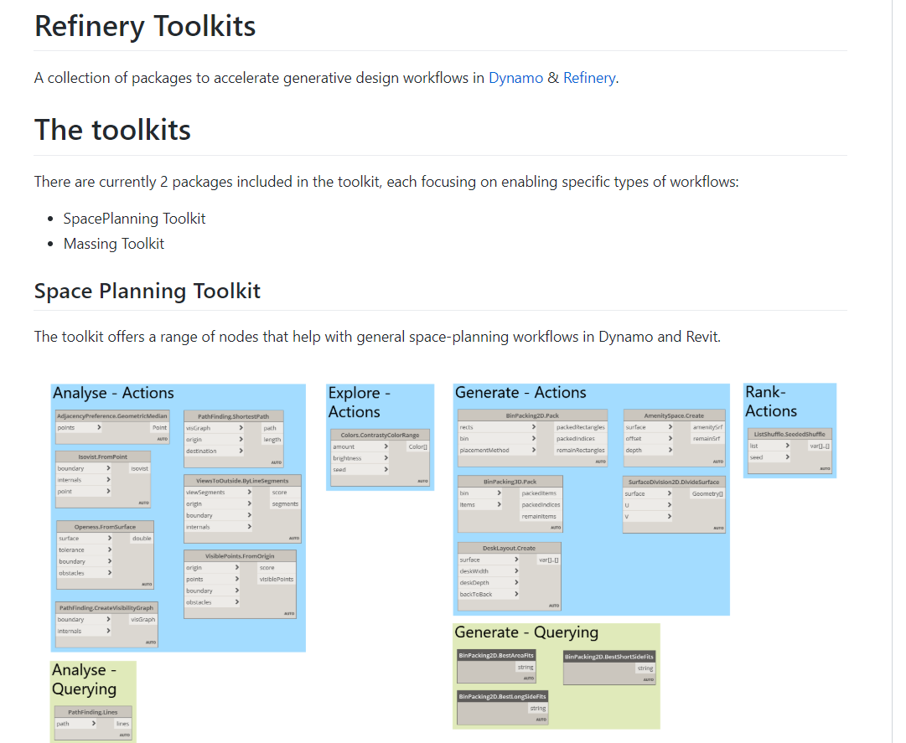

Slide 11
Why?

Slide 12
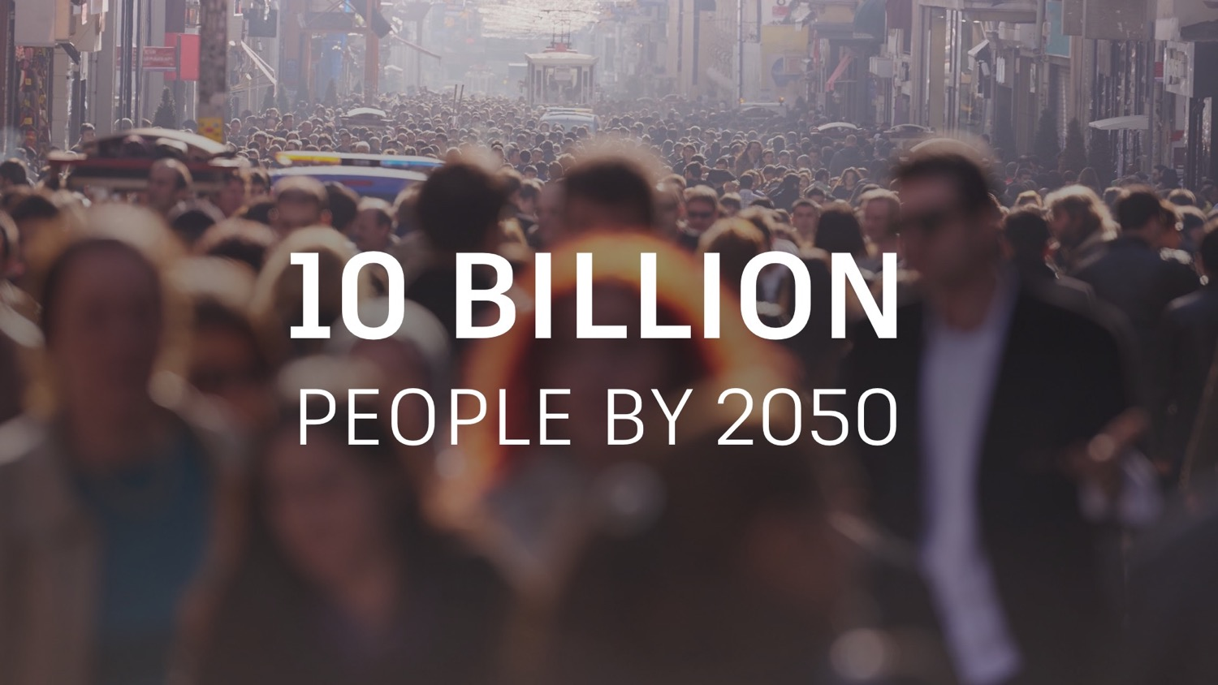
Notes:
We know that by 2050 there will be 10 billion of us.
What we might not all know is that the global middle class is growing faster than at any time in our history.
In 1990, only 23% of the global population had sufficient income to be classified as middle class. Today, 45% of us do.

Slide 13

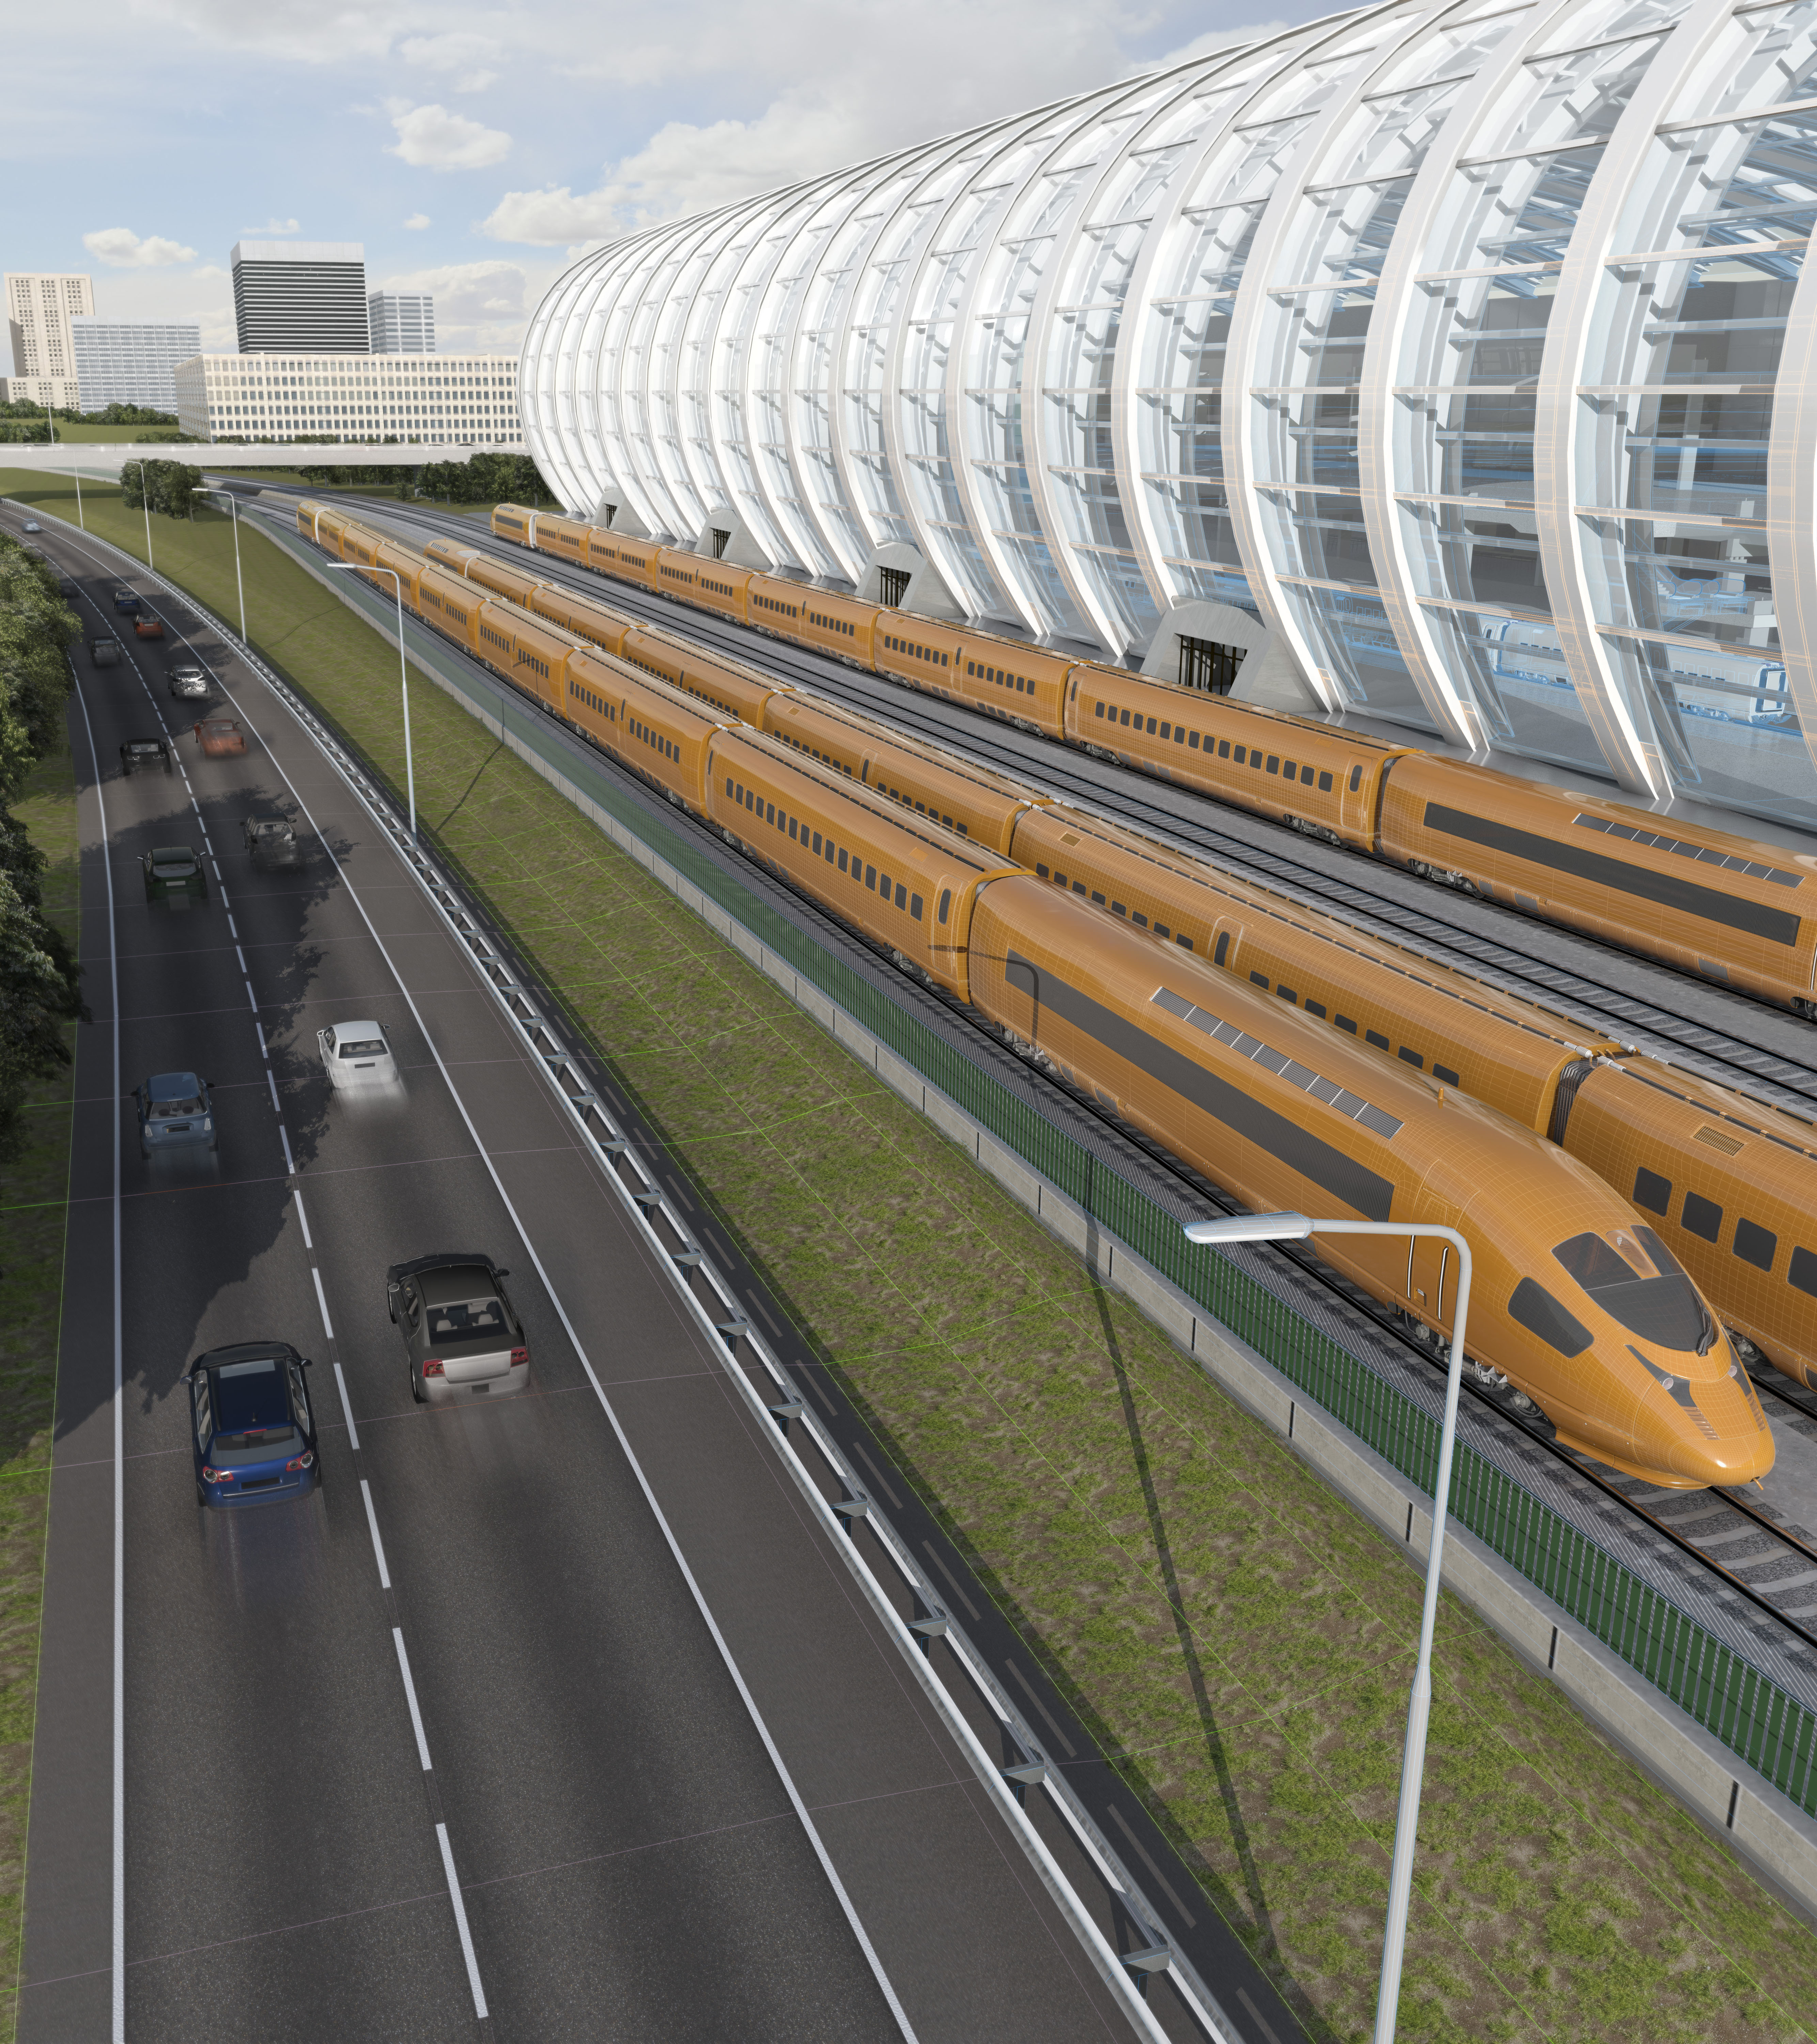
30x
AROUND THE EARTH / PER YEAR
13,000
BUILDINGS A DAY
Notes:
Recently Autodesk partnered with a firm called Statista to calculate just how much work …
<click>
We’re going to have to build 13,000 buildings every day
<click>
And enough roads and rail to wrap around the earth six times every year …
That’s over 1.2 million km of roads and rail needed for our global infrastructure each and every year between now and 2050

Slide 14
Problem: more work at a higher quality with less resources
Notes:
I’m going to assert that there is a problem
Most people just evaluate a few designs, generative design can let you study much more.

Slide 15
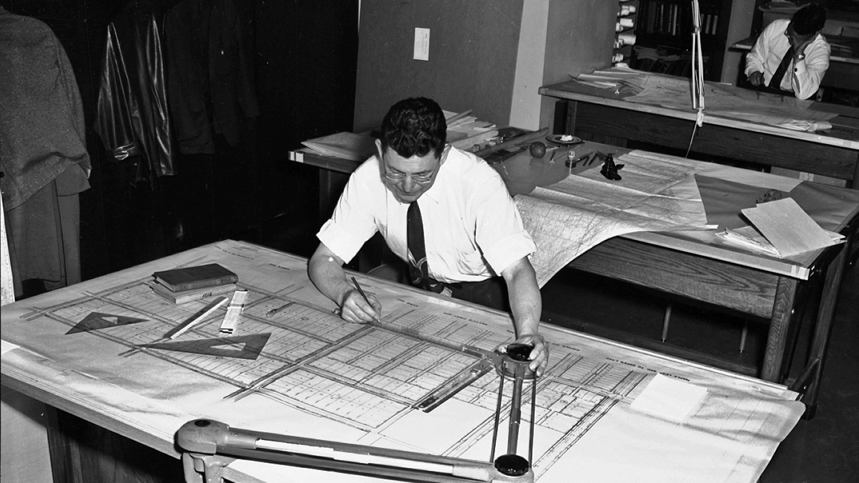
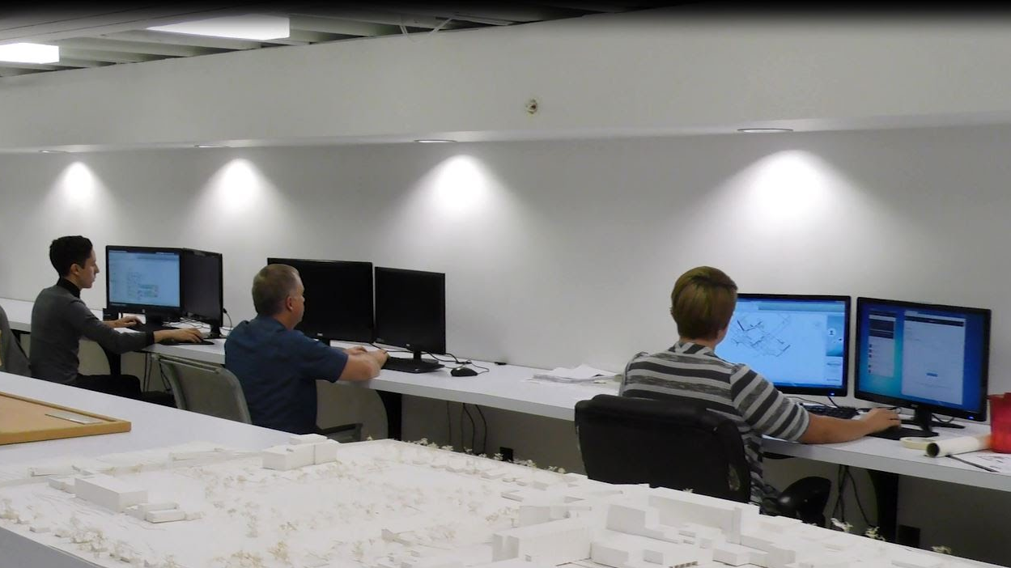
Notes:
This has been the traditional way of delivering buildings
Recording it on paper and delivering it to others who execute to build it
We've evolved to computerizing drawings making them more data rich and easier to updated

Slide 16
Notes:
But what we really want to do now is to capture what’s in these people’s heads

Slide 17
Professional Intelligence
Algorithmic Opportunity
Notes:
Combine intelligence of building professional with algorithmic intelligence to produce better buildings, faster.

Slide 18
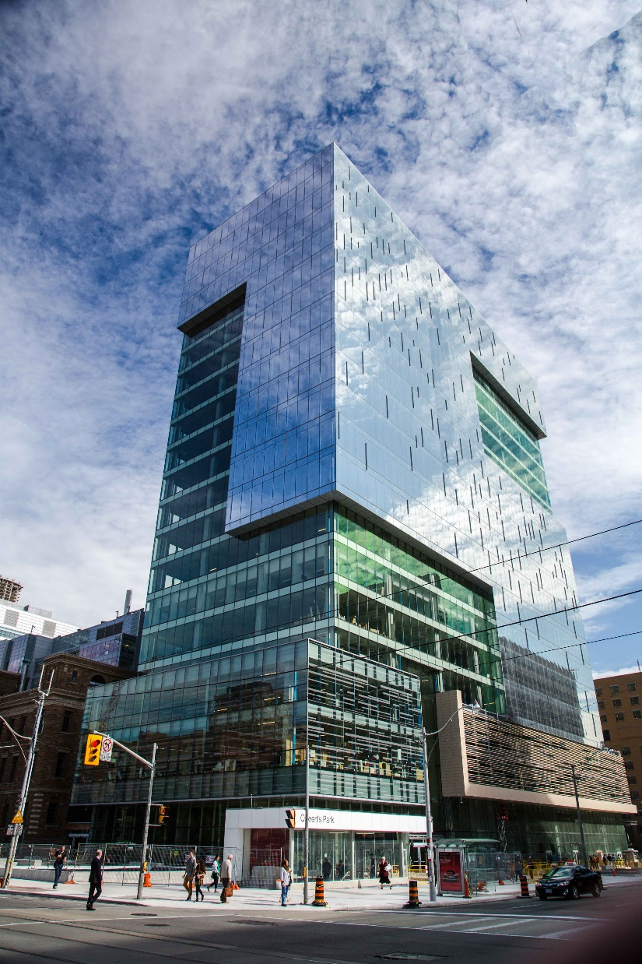



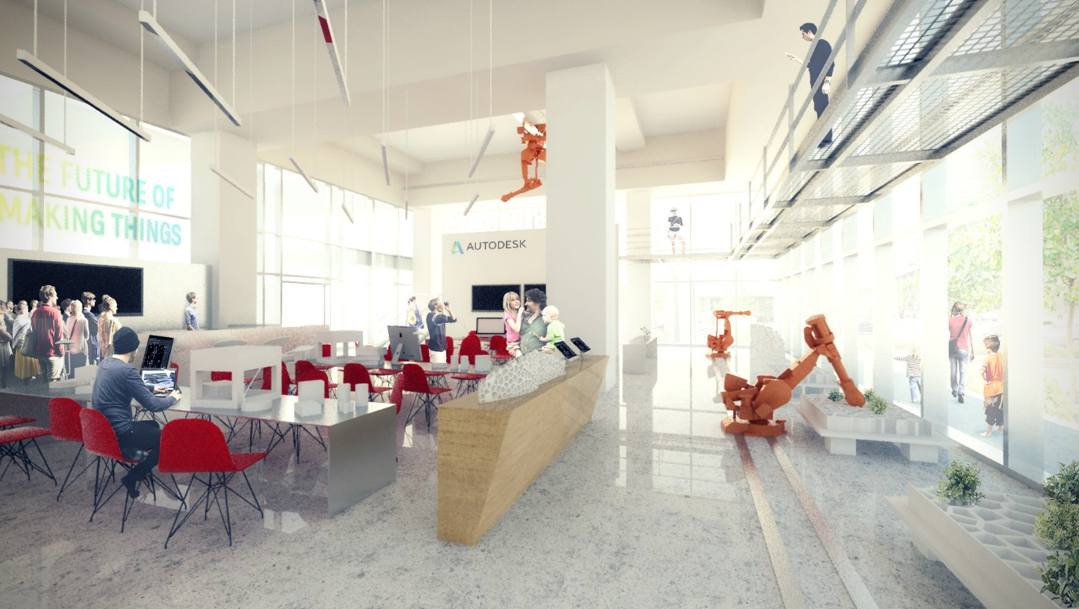
Notes:
We are also doing experiments with these workflows inside of Autodesk.
Recently, we moved our Toronto office to a new office in the MaRS innovation district. The Living, an architecture firm that Autodesk purchased to test out ideas, used a generative approach to design the new office’s space layout.

Slide 19
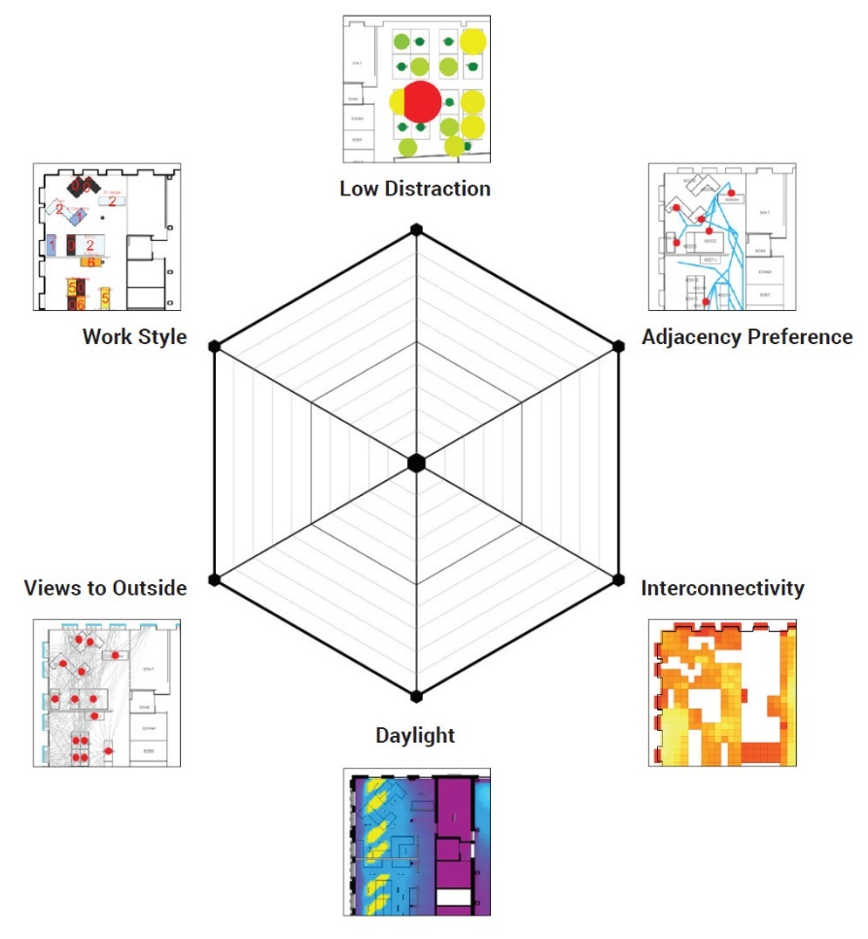
Notes:
They boiled all this data down to six measurable goals for a good office and created algorithms to measure each goal.

Slide 20
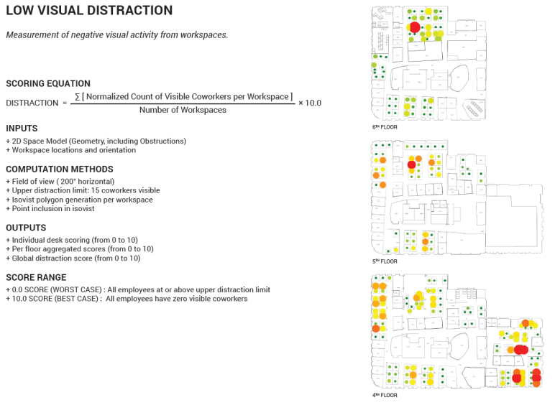
Notes:
To generate viable space plan proposals reliable results, the Living created a series of formulae to arrive at optimal solutions…

Slide 21
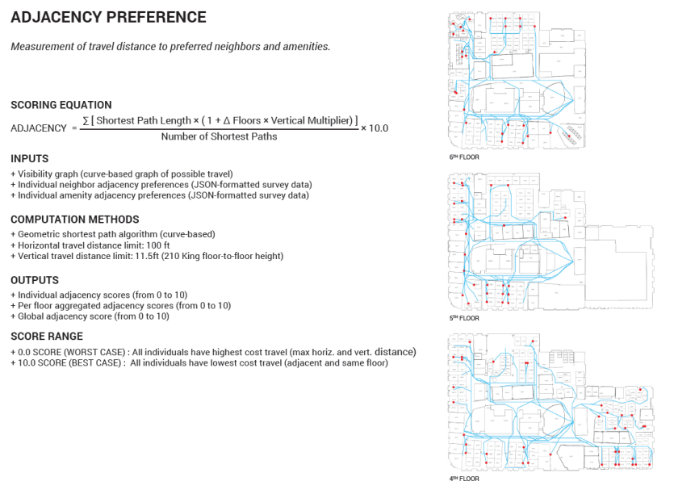
Notes:
To generate viable space plan proposals reliable results, the Living created a series of formulae to arrive at optimal solutions…

Slide 22
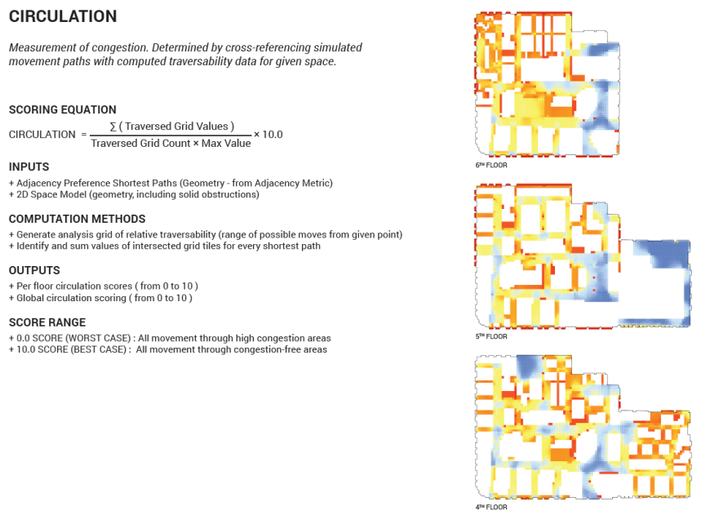
Notes:
To generate viable space plan proposals reliable results, the Living created a series of formulae to arrive at optimal solutions…

Slide 23
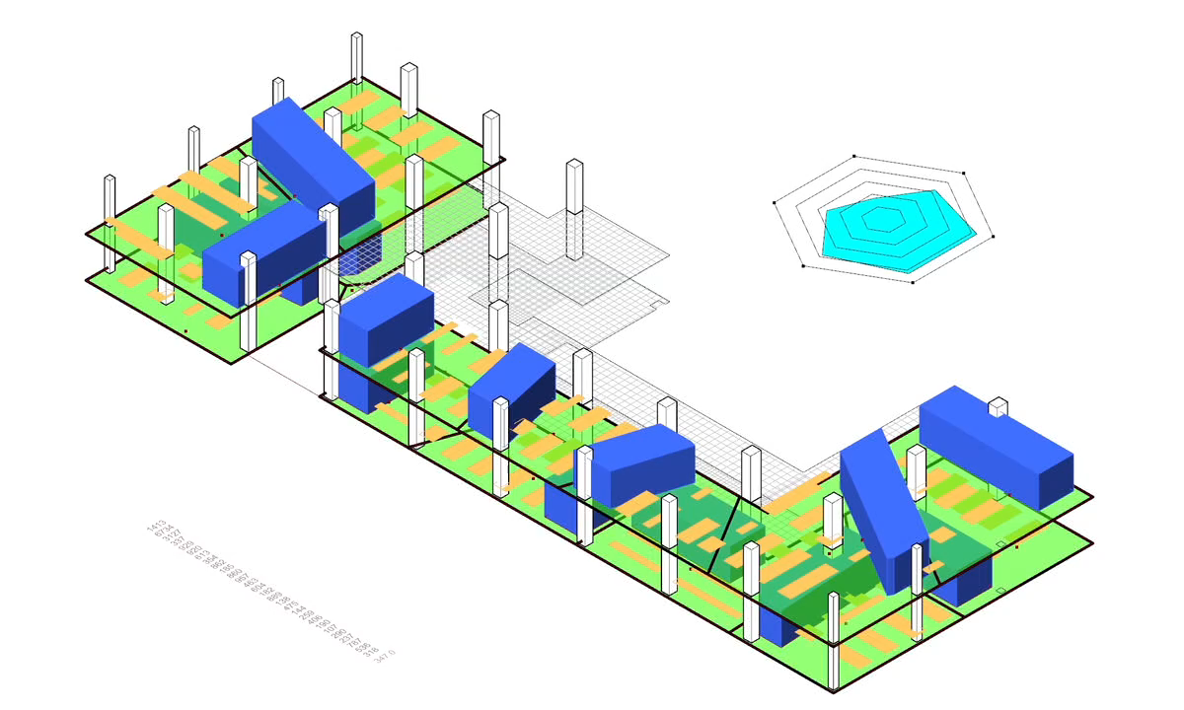
Notes:
Here you can see the process running, as different floor plan layouts are created, each with blue amenity bars of meeting rooms and yellow locations of desks.
Each design option also involves a “dashboard” of performance according to its score on the six goals.

Slide 24

Notes:
They set up variables so that designers could flex them to see what the effects of the variables are.
They generated 10s of 1000s of options, developed methodology to sort through them and help them make decisions.

Slide 25
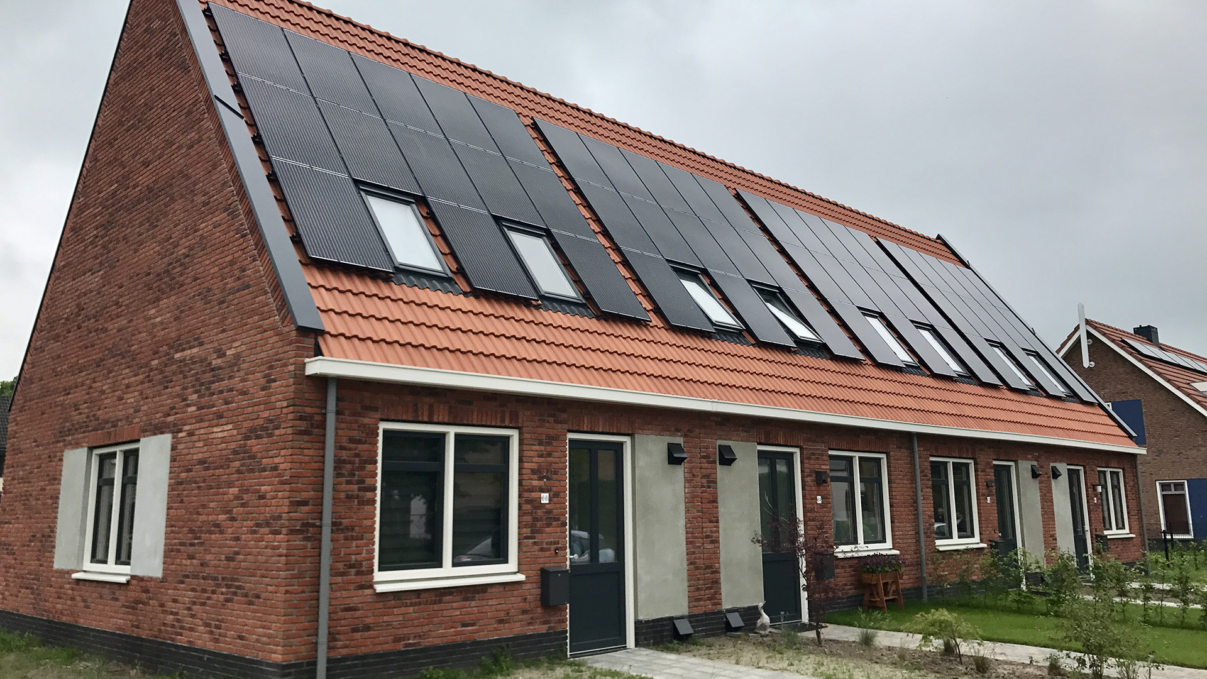
Notes:
Autodesk Research and The Living also worked on a project with the Dutch construction company Van Wijnen. In this project they followed a similar workflow where they identified certain goals, developed ways to measure those goals, developed a flexible model, and used the computer to help generate, evolve, and rank their designs.

Slide 26
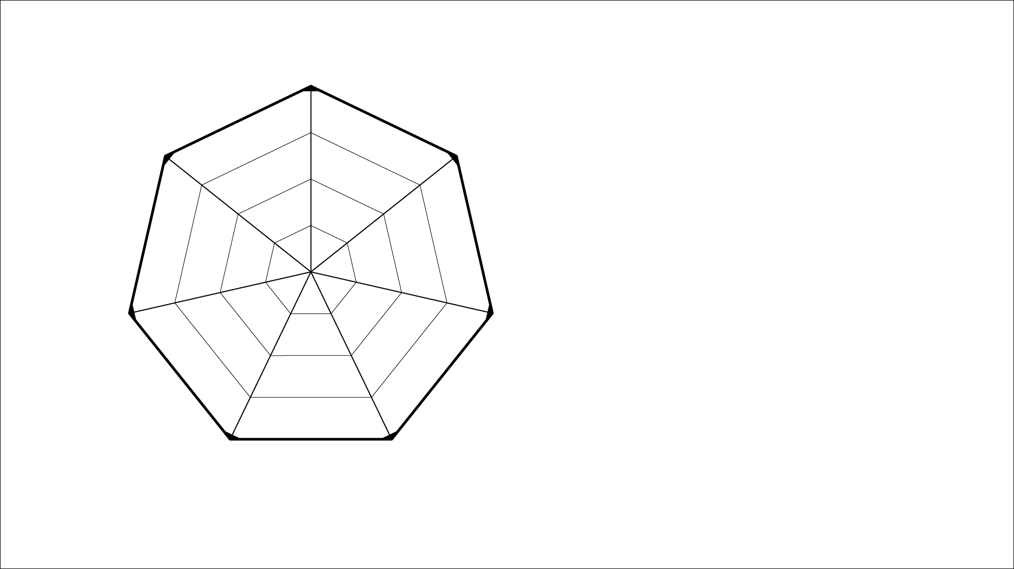

Slide 27
“We want to be able to learn from more designs than it is physically possible to generate or evaluate ‘by hand’.” – Danil Nagy, The Living
Notes:
the outcome of the search is completely dependent on the design of the design space, as well as the specification of various measures and search parameters. So you do you design a good design space?
Some things to keep in mind…

Slide 28
How!?

Slide 29
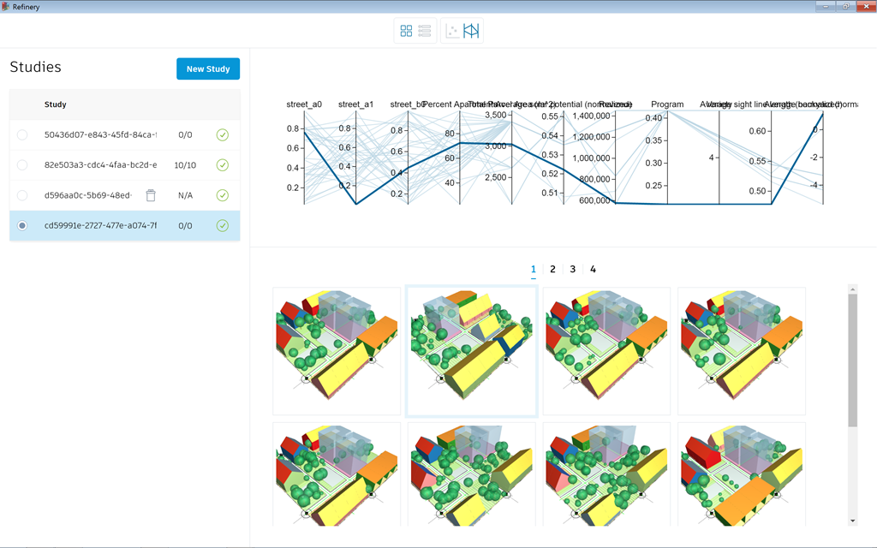
What is Project Refinery?
Automatically run Dynamo created logic to create options
Works on Dynamo for Revit or Dynamo Sandbox
Created for one customer VanWijnen 2/2018
Public Beta 11/2018

Slide 30
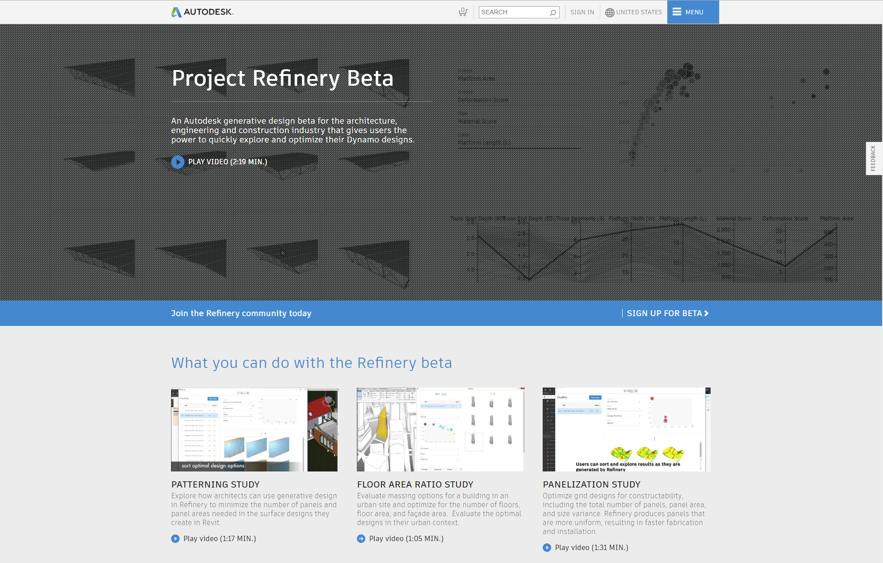

autodesk.com/solutions/refinery-beta

Slide 31
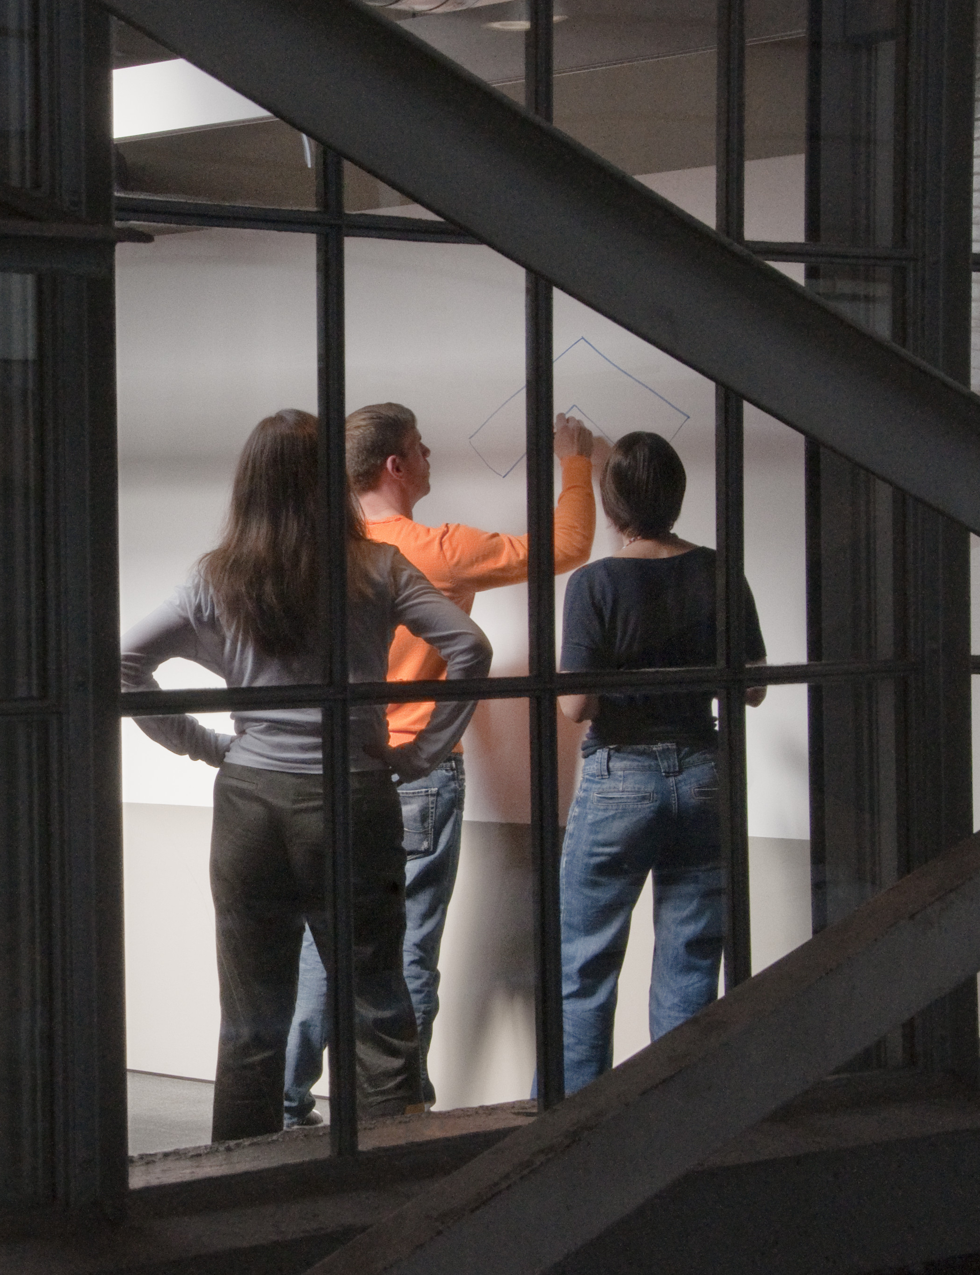
Generative Design Preparation
How to get started
Understand what you want to achieve
Define your problem
Decide on ways to measure success
Think about how to review the results
Notes:
The traditional architectural design process is similar to the generative design process in many ways. In the traditional architectural design process, you ask for requirements from your client – how big a building do you want? What kinds of spaces to you need in the building? What goals do you have for the design?
This traditional process of identifying goals and requiements is still important when incorporating generative design techniques. With generative design you usually can’t design all aspects of a building in one automated process, you have to identify what kinds of problems might be good to look at in ways that the computer can help you to generate options and evaluate them. But you are still defining goals and measuring success. It’s critical to design how the problem with be generated by the computer and how you will measure success. How are you going to make decisions on the results?

Slide 32
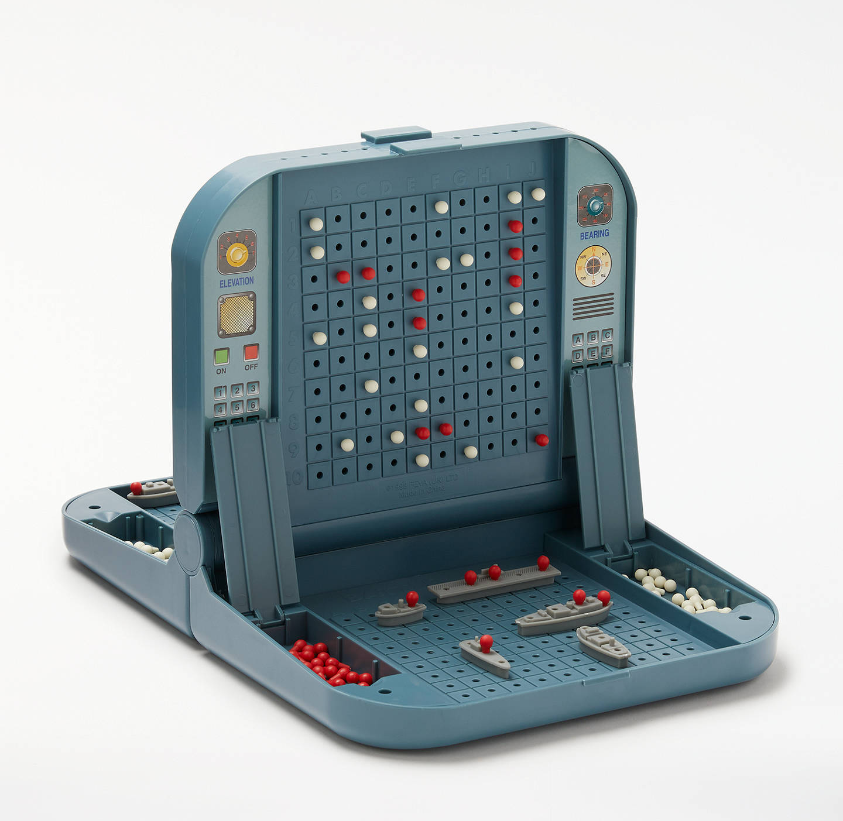
Traditional Design Process
Notes:
Traditional Design process is a little bit like a game of battle ship. Ideas are tested one at a time. “does this work?” “what about this?” You might get a hit, you might get a miss. Often times only a few designs can really be evaluated because you run out of time. Solutions presented on cost only when you really want to show the client more options.

Slide 33
Generative Design Process
Refinery generates iterations on your behalf
Constraints
Concept
Goals
Evaluate
Detail
Curate
PEOPLE
COMPUTER
PEOPLE

Slide 34
“The goal of generative design is not to automate the design process, or to replace human designers with artificial ones” – Danil Nagy, The Living
Notes:
the outcome of the search is completely dependent on the design of the design space, as well as the specification of various measures and search parameters. So you do you design a good design space?
Some things to keep in mind…

Slide 35
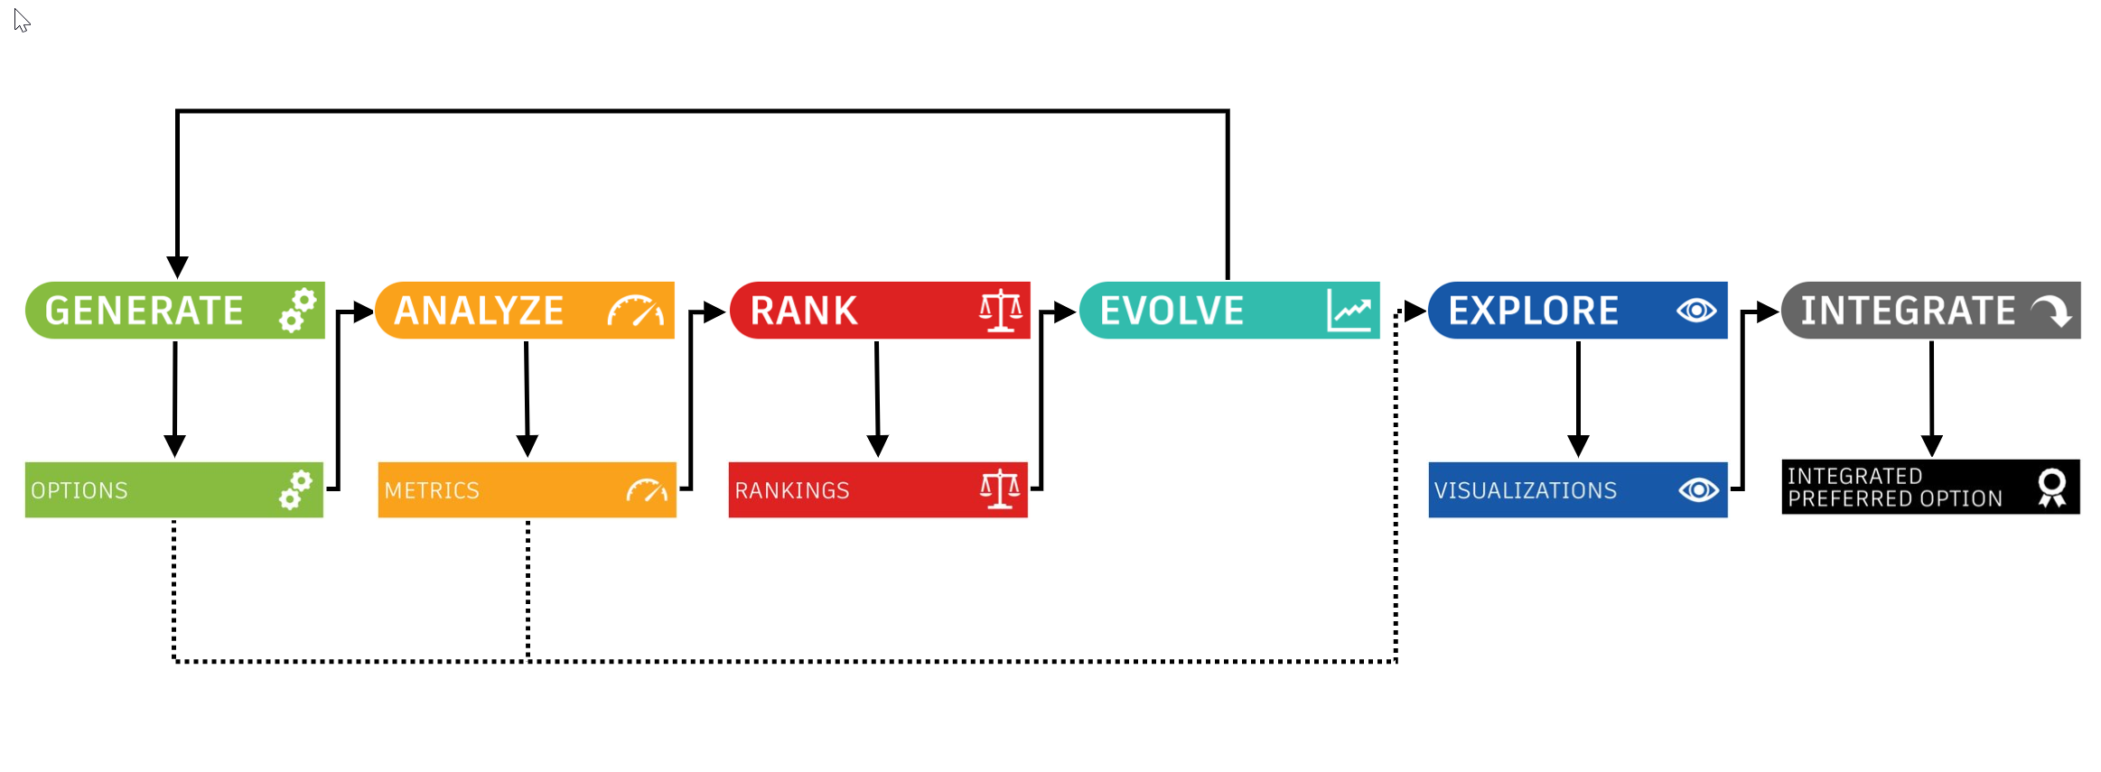
Generative Design Method
Process diagram
Notes:
How is your model going to flex to create different options?
How are you going to measure success?
How do other options compare?
How can the computer help you to generate options to evolve your design to the best design for your goals?
How can you visualize the results ---- and explain the best options to your clients?
Once you decide on a direction, how can you integrated it into other programs for further work?

Slide 36
3 Box Building Let’s start simple to understand concepts
Example 1
Notes:
Be sure to always include a title and a subhead

Slide 37
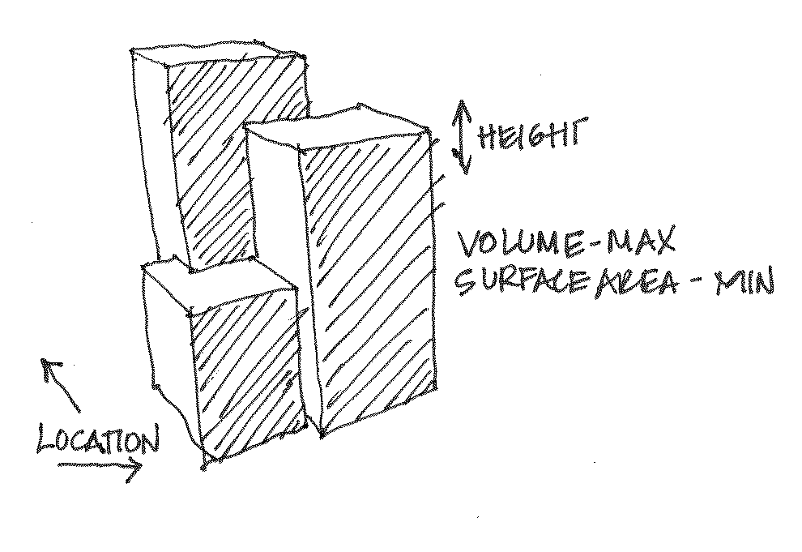
Goals
What are we solving for?
Study a building mass to look at trade offs between volume and surface area
Variable Inputs:
Locations of 2 of the boxes
Heights of all 3 boxes
Goals:
Maximum volume (rentable area)
Minimum surface area (expensive façade)

Slide 38
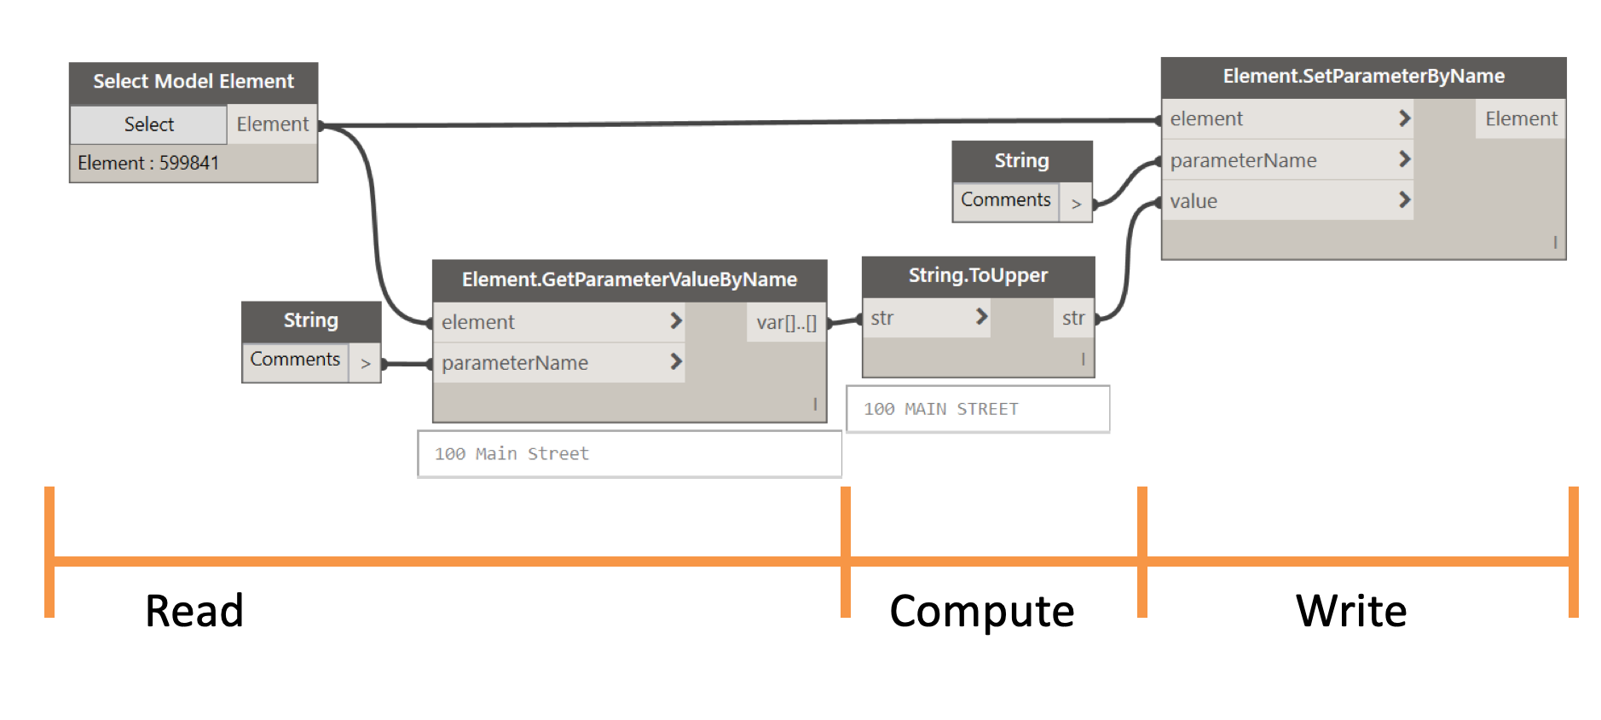
Quick Dynamo Primer
Visual programming for architects and engineers

Slide 39
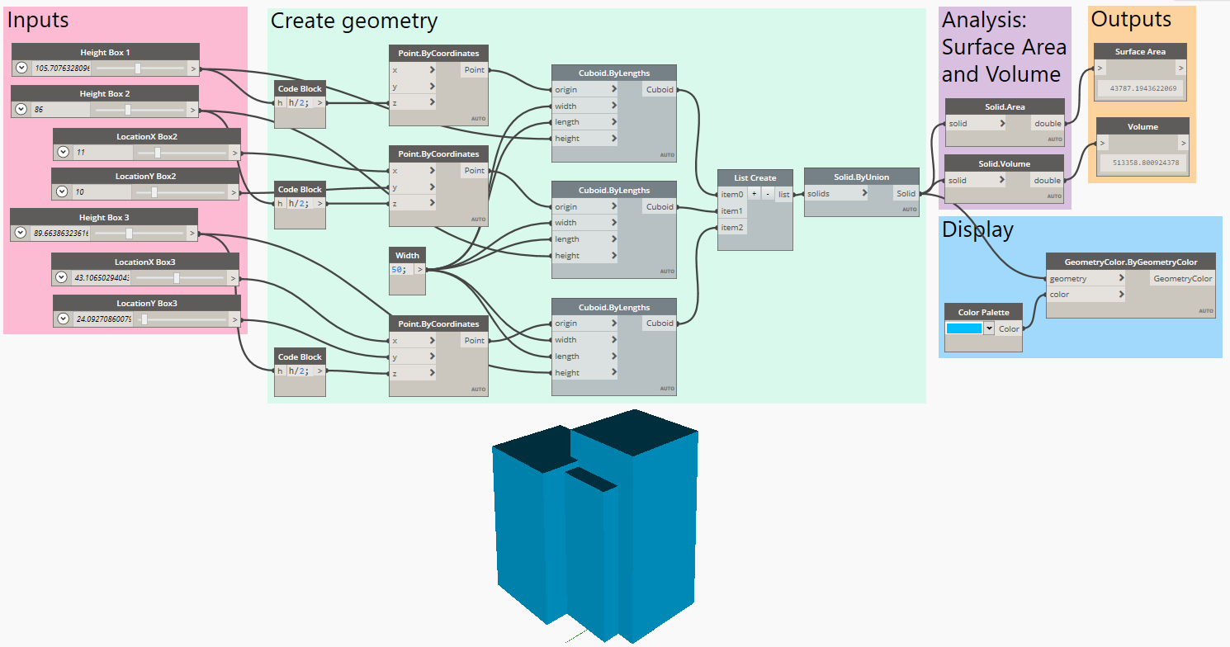
INPUTS
GEOMETRY
EVALUATORS
Notes:
Types of inputs

Slide 40







Slide 41
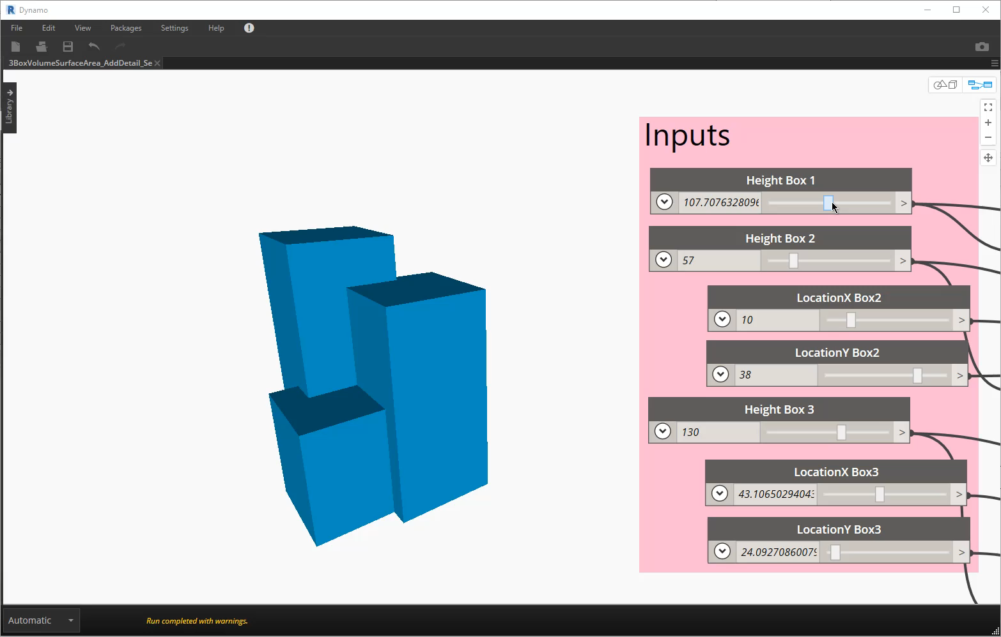
Notes:
Pink box inputs
Green box geometry creation
Critical to define how the geometry flexes.

Slide 42
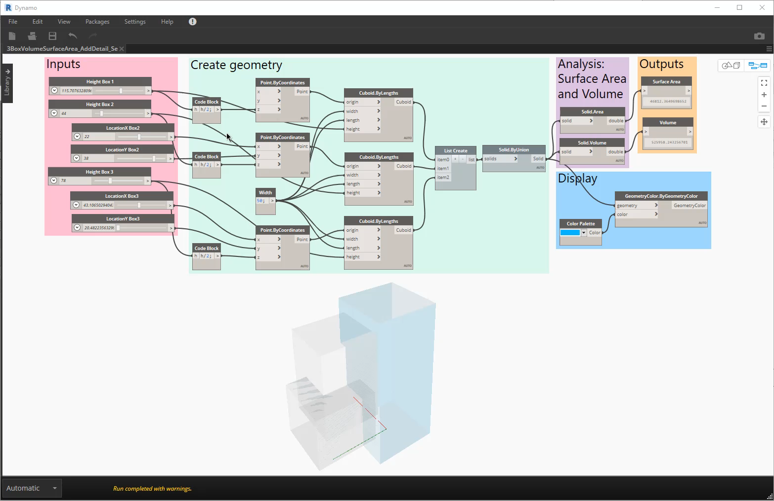

Slide 43
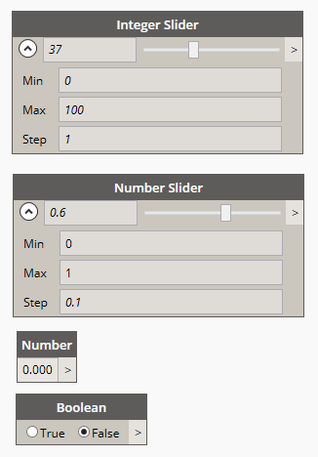
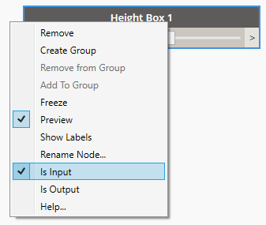
Input types
VARIABLE
FIXED
REFINERY
Notes:
Types of inputs

Slide 44
Generate
Create a design system: 3 key concepts
How you parametrize the model is critical
Too many inputs will lead to a design space that is too big to explore
Too few inputs won’t yield a big enough design space
Notes:
Human process

Slide 45
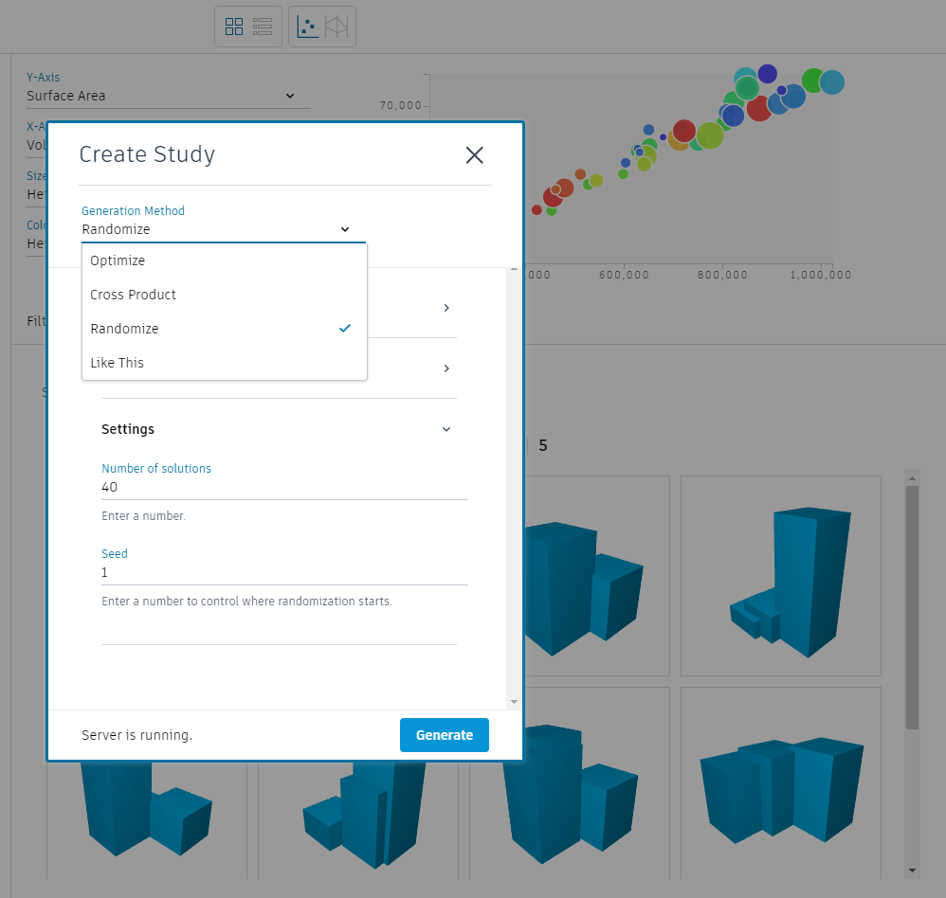
Refinery Generation Methods
Optimize
Cross Product
Randomize
Like This

Slide 46
Refinery Methods
4 TYPES
RANDOMIZE
INPUTS
DESIGN SPACE
OUTCOME
Parameter 1
Parameter 2
Parameter 1
Parameter 2
Notes:
Deterministic methods
Save · an individual option by editing input values on Refinery
Cross-product · to survey the whole design space
Randomize · to obtain random input configurations/ good for testing the model
Like this · to apply slight variations to your current input configuration
Optimize · a set of output parameters of a parametric model to improve the performance of your design

Slide 47
Refinery Methods
4 TYPES
RANDOMIZE
INPUTS
DESIGN SPACE
OUTCOME
Parameter 1
5 DESIGNS
# defined by user
Parameter 2
Parameter 1
Parameter 2
Notes:
Deterministic methods
Save · an individual option by editing input values on Refinery
Cross-product · to survey the whole design space
Randomize · to obtain random input configurations
Like this · to apply slight variations to your current input configuration
ntelligence methods
Optimize · a set of output parameters of a parametric model to improve the performance of your design

Slide 48
Refinery Methods
4 TYPES
RANDOMIZE
CROSS PRODUCT
INPUTS
DESIGN SPACE
OUTCOME
Parameter 1
5 DESIGNS
# defined by user
Parameter 2
Parameter 1
Parameter 2
5x
Parameter 1
5 x 3 = 15 DESIGNS
user defines sampling density
3x
Parameter 2
Parameter 1
Parameter 2
Notes:
Deterministic methods
Save · an individual option by editing input values on Refinery
Cross-product · to survey the whole design space
Randomize · to obtain random input configurations
Like this · to apply slight variations to your current input configuration
intelligence methods
Optimize · a set of output parameters of a parametric model to improve the performance of your design

Slide 49
Refinery Methods
4 TYPES
RANDOMIZE
CROSS PRODUCT
OPTIMIZE
INPUTS
DESIGN SPACE
OUTCOME
Parameter 1
5 DESIGNS
# defined by user
Parameter 2
Parameter 1
Parameter 2
5x
Parameter 1
5 x 3 = 15 DESIGNS
user defines sampling density
3x
Parameter 2
Parameter 1
Parameter 2
generation 1
population of 3
Parameter 1
Parameter 2
Parameter 1
Parameter 2
Notes:
Deterministic methods
Save · an individual option by editing input values on Refinery
Cross-product · to survey the whole design space
Randomize · to obtain random input configurations
Like this · to apply slight variations to your current input configuration
intelligence methods
Optimize · a set of output parameters of a parametric model to improve the performance of your design

Slide 50
Refinery Methods
4 TYPES
RANDOMIZE
CROSS PRODUCT
OPTIMIZE
INPUTS
DESIGN SPACE
OUTCOME
Parameter 1
5 DESIGNS
# defined by user
Parameter 2
Parameter 1
Parameter 2
5x
Parameter 1
5 x 3 = 15 DESIGNS
user defines sampling density
3x
Parameter 2
Parameter 1
Parameter 2
generation 1
population of 3
Parameter 1
3 x 6 = 18 DESIGNS
user defines population size and number of generations
generation 2
population of 3
Parameter 2
Parameter 1
…
generation 6
population of 3
Parameter 2
Notes:
Deterministic methods
Save · an individual option by editing input values on Refinery
Cross-product · to survey the whole design space
Randomize · to obtain random input configurations
Like this · to apply slight variations to your current input configuration
intelligence methods
Optimize · a set of output parameters of a parametric model to improve the performance of your design

Slide 51
Refinery Methods
4 TYPES
RANDOMIZE
CROSS PRODUCT
OPTIMIZE
LIKE THIS
INPUTS
DESIGN SPACE
OUTCOME
Parameter 1
5 DESIGNS
# defined by user
Parameter 2
Parameter 1
Parameter 2
5x
Parameter 1
5 x 3 = 15 DESIGNS
user defines sampling density
3x
Parameter 2
Parameter 1
Parameter 2
generation 1
population of 3
Parameter 1
3 x 6 = 18 DESIGNS
user defines population size and number of generations
generation 2
population of 3
Parameter 2
Parameter 1
…
generation 6
population of 3
Parameter 2
Parameter 1
Parameter 2
Parameter 1
Parameter 2
Notes:
Deterministic methods
Save · an individual option by editing input values on Refinery
Cross-product · to survey the whole design space
Randomize · to obtain random input configurations
Like this · to apply slight variations to your current input configuration
intelligence methods
Optimize · a set of output parameters of a parametric model to improve the performance of your design

Slide 52
Refinery Methods
4 TYPES
RANDOMIZE
CROSS PRODUCT
OPTIMIZE
LIKE THIS
INPUTS
DESIGN SPACE
OUTCOME
Parameter 1
5 DESIGNS
# defined by user
Parameter 2
Parameter 1
Parameter 2
5x
Parameter 1
5 x 3 = 15 DESIGNS
user defines sampling density
3x
Parameter 2
Parameter 1
Parameter 2
generation 1
population of 3
Parameter 1
3 x 6 = 18 DESIGNS
user defines population size and number of generations
generation 2
population of 3
Parameter 2
Parameter 1
…
generation 6
population of 3
Parameter 2
Parameter 1
5 DESIGNS
# defined by user
Parameter 2
Parameter 1
Parameter 2
Notes:
Deterministic methods
Save · an individual option by editing input values on Refinery
Cross-product · to survey the whole design space
Randomize · to obtain random input configurations
Like this · to apply slight variations to your current input configuration
intelligence methods
Optimize · a set of output parameters of a parametric model to improve the performance of your design

Slide 53
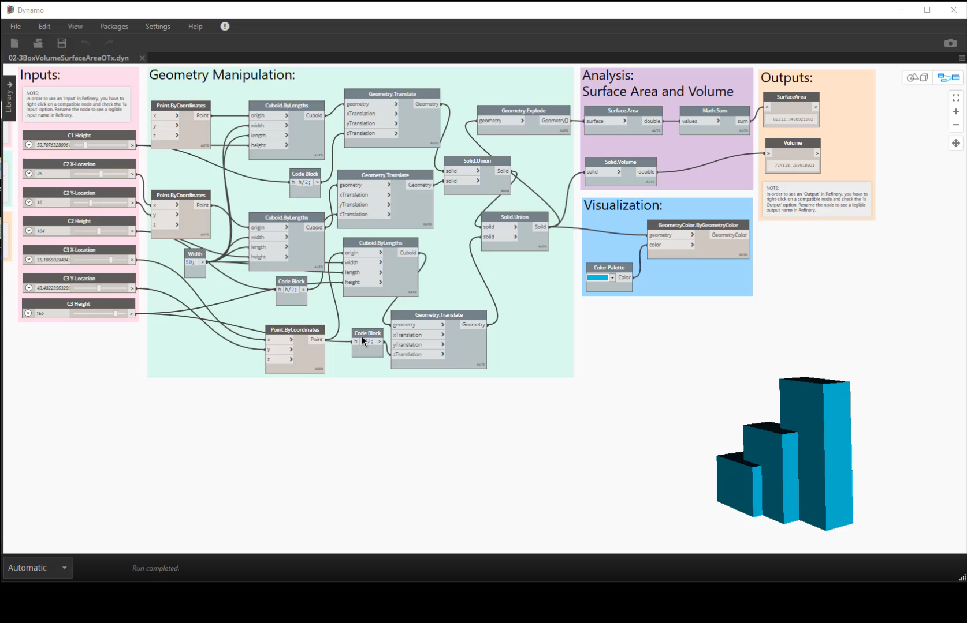
Notes:
Can quickly create random options

Slide 54
Notes:
But we need something to guide our study

Slide 55
Judging outcomes
Critical 2nd half of the problem
Set of measures that determine how the building is performing
Why?
Compare designs objectively (apples to apples)
Evaluate designs based on non-intuitive measures
Explore more designs than is possible manually
85%
91%
94%

Slide 56
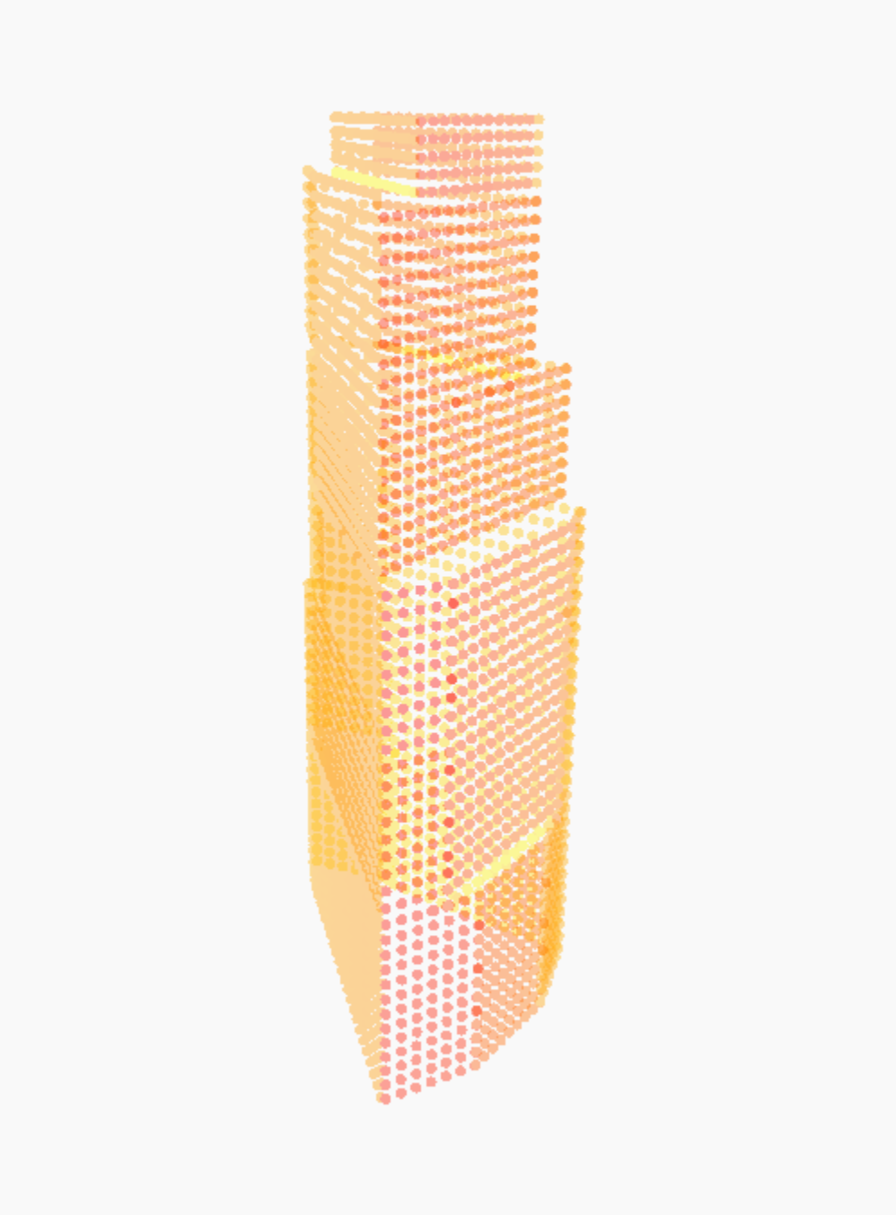
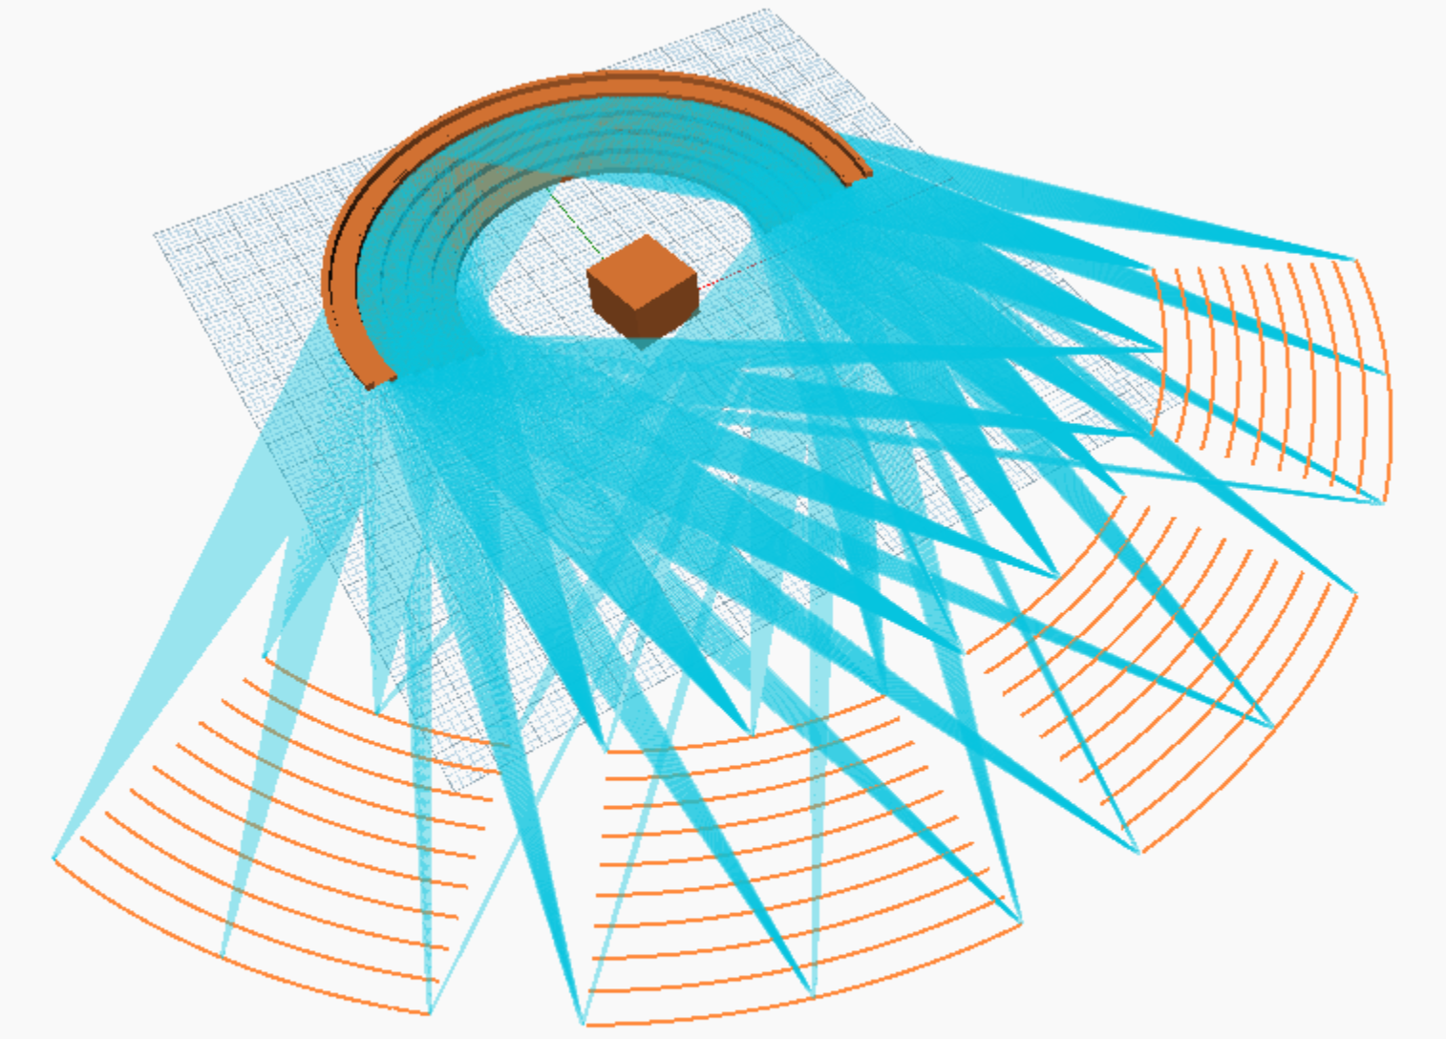
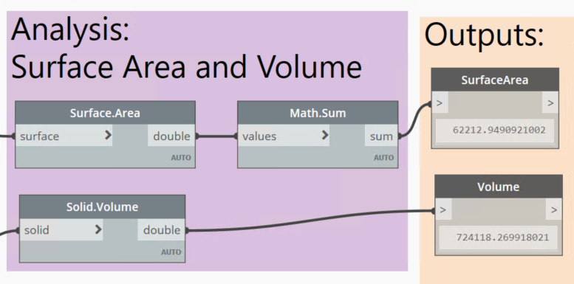
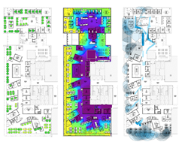
Types of measurement
BEAUTY
PERSONAL PREFERENCE
AESTHETIC SENSIBILITY
SIMPLE
length x width=area
COMPLEX
Simulation
UNMEASURABLE
Notes:
Goals here were to study building forms with most volume and least surface area (measurable)
Could add more complex measurement types like solar radiation if I wanted to measure that…
But also aesthetic preferences among those designs (unmeasurable)

Slide 57
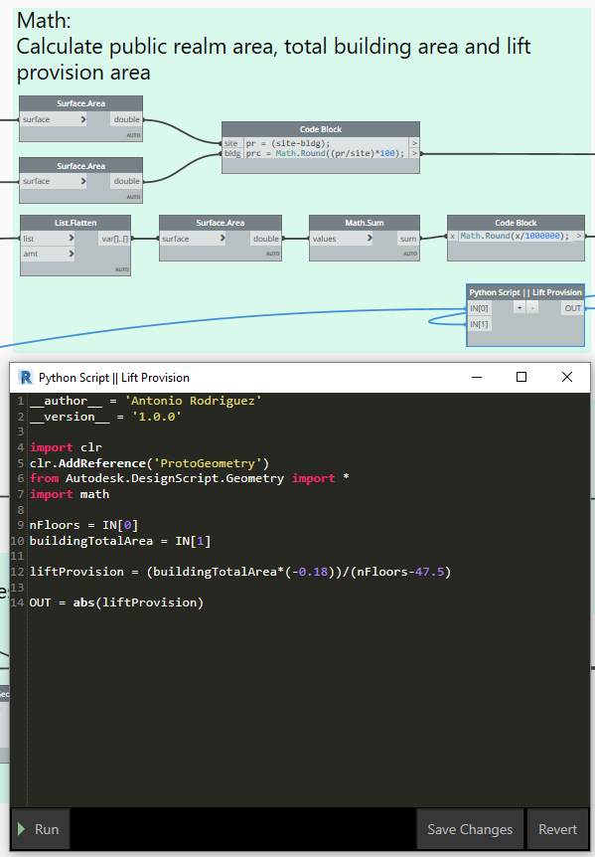
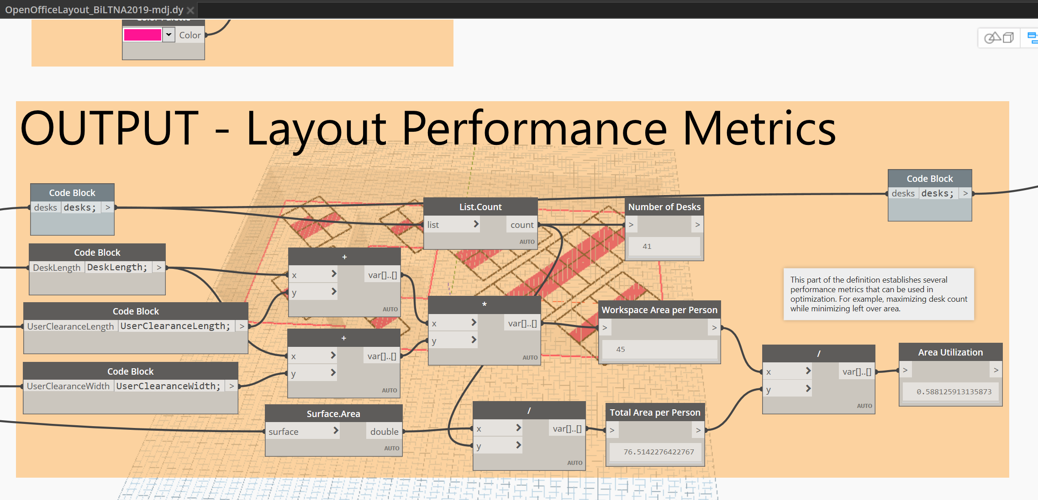
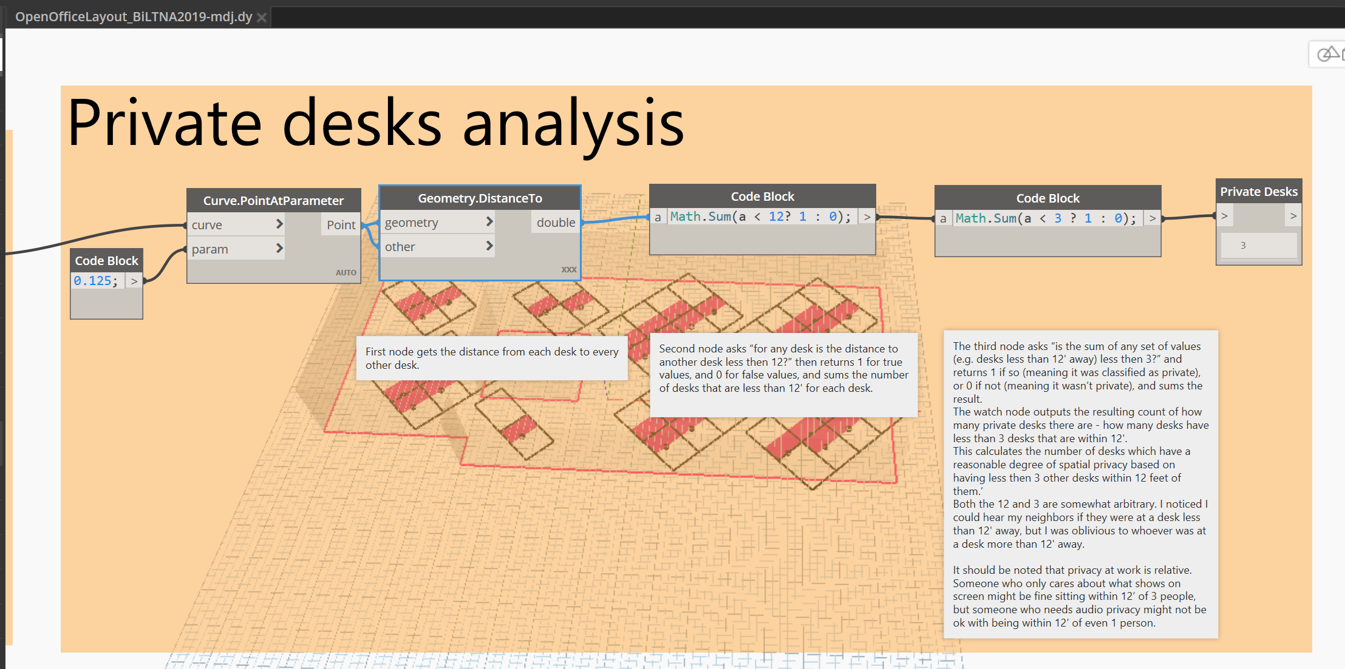
Types of measurement
Notes:
Goals here were to study building forms with most volume and least surface area (measurable)
Could add more complex measurement types like solar radiation if I wanted to measure that…
But also aesthetic preferences among those designs (unmeasurable)

Slide 58
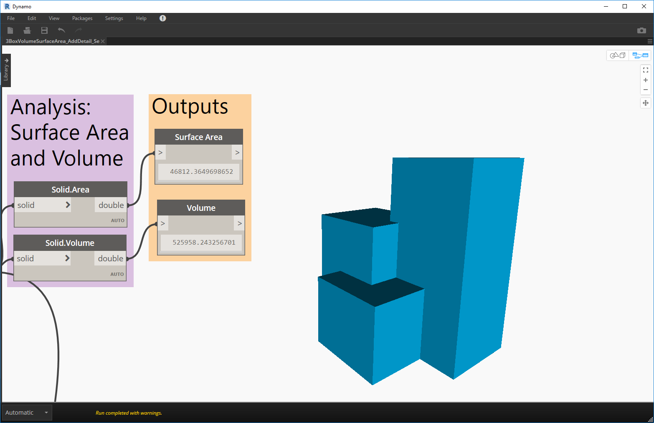
Measuring goals
Notes:
Types of inputs

Slide 59

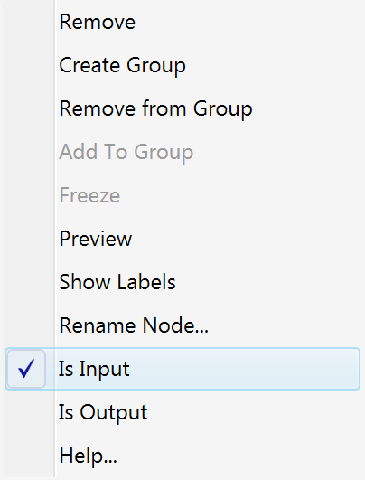
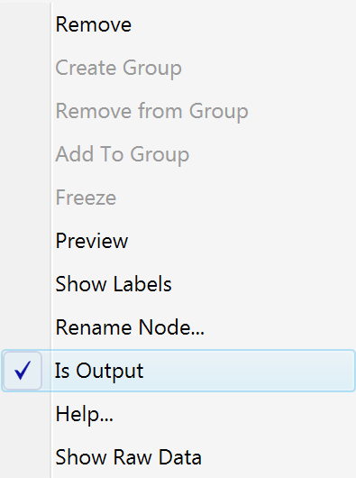
Designating Refinery inputs and outputs
Notes:
Types of inputs

Slide 61
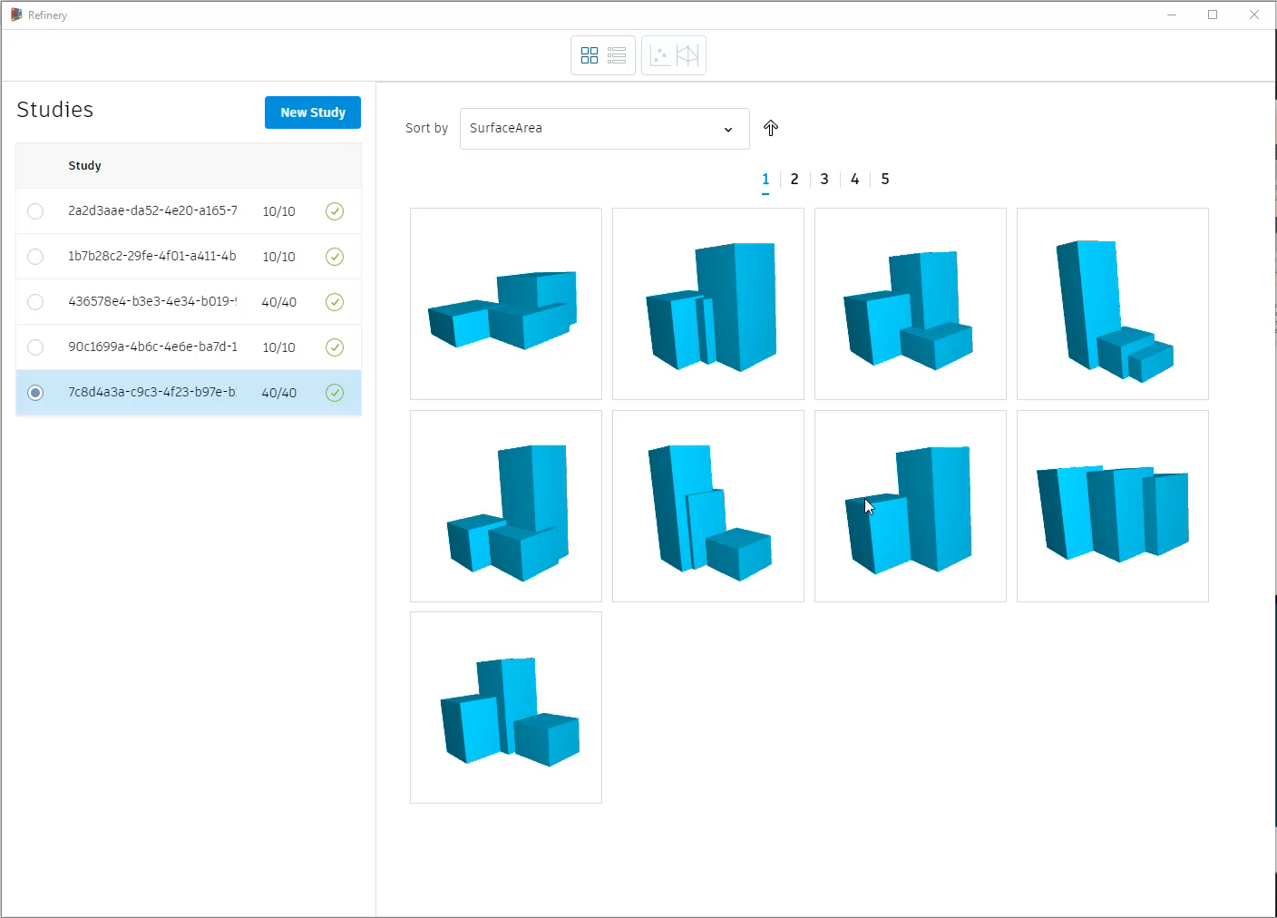
3. Rank
Refinery sort
Notes:
Compare designs that fulfil our design goals by sorting by Surface Area and then Volume

Slide 62
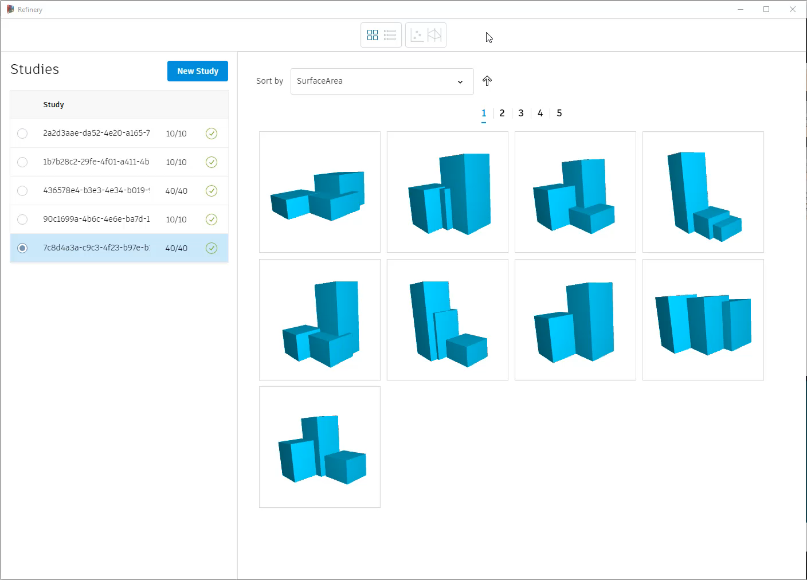
3. Rank
Manual "optimization"
Notes:
Using the built in graph functionality you can compare these metrics against eachother and filter to find the compromise options that meet both goals.

Slide 63
3. Evolve

Slide 64
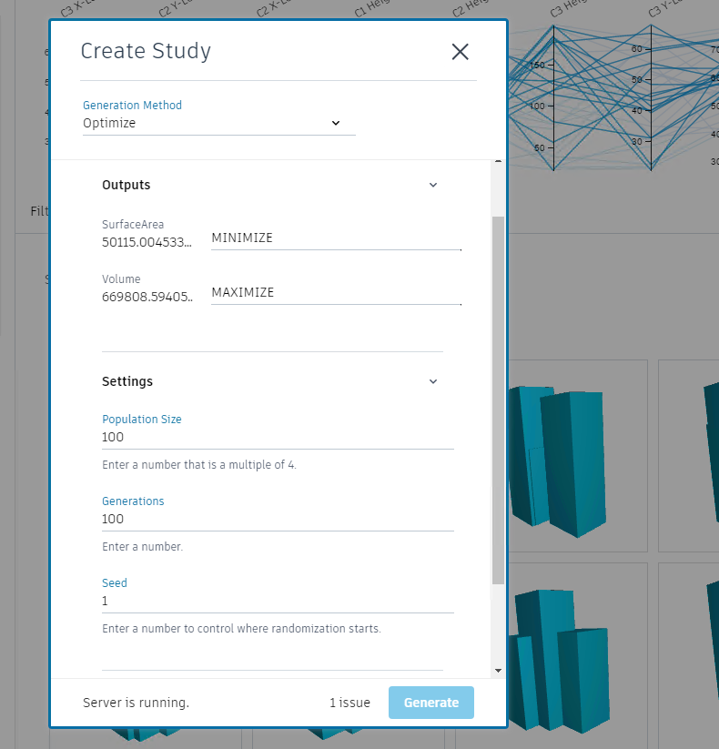
Parameters that effect the algorithm
Output goals
Population size
Generation size
Seed
Notes:
We are parametrically setting nsga2 settings like mutation rate and cross over chance. The values change based on number of inputs and input range.

Slide 65
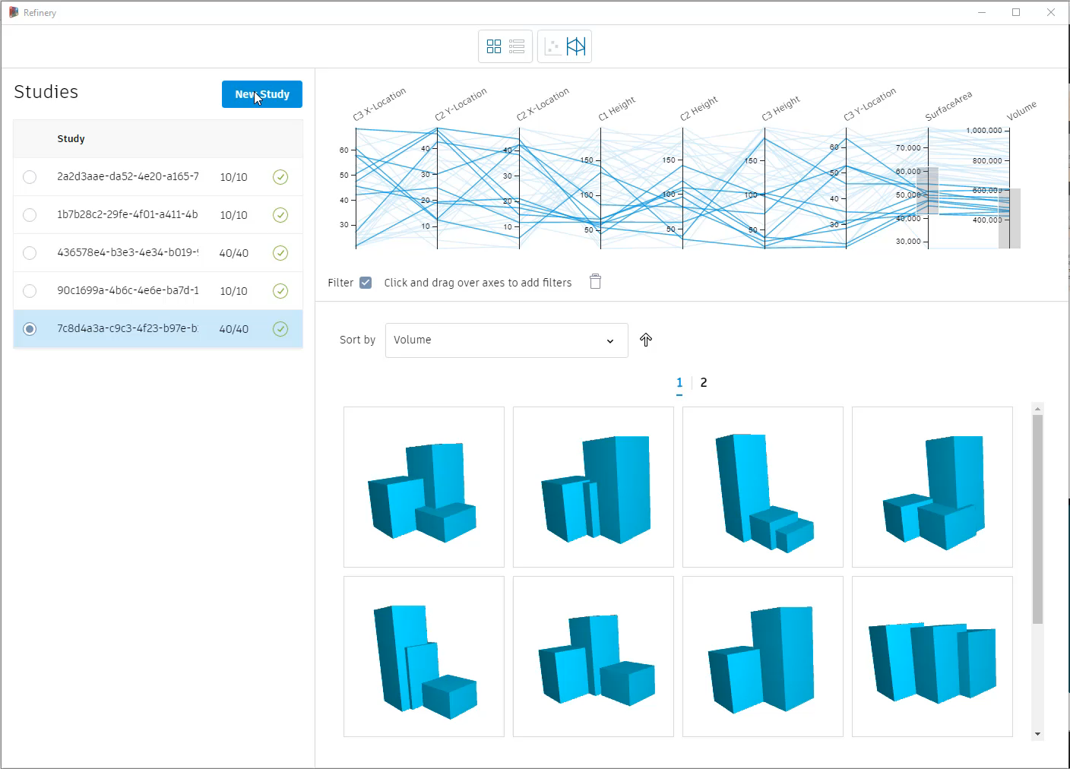
Refinery optimization

Slide 66
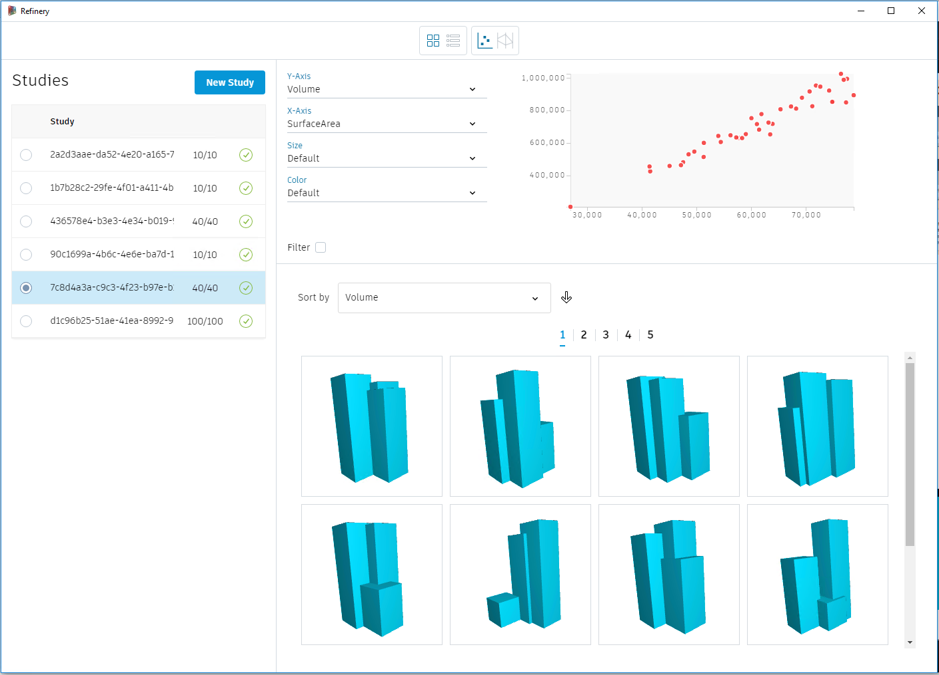
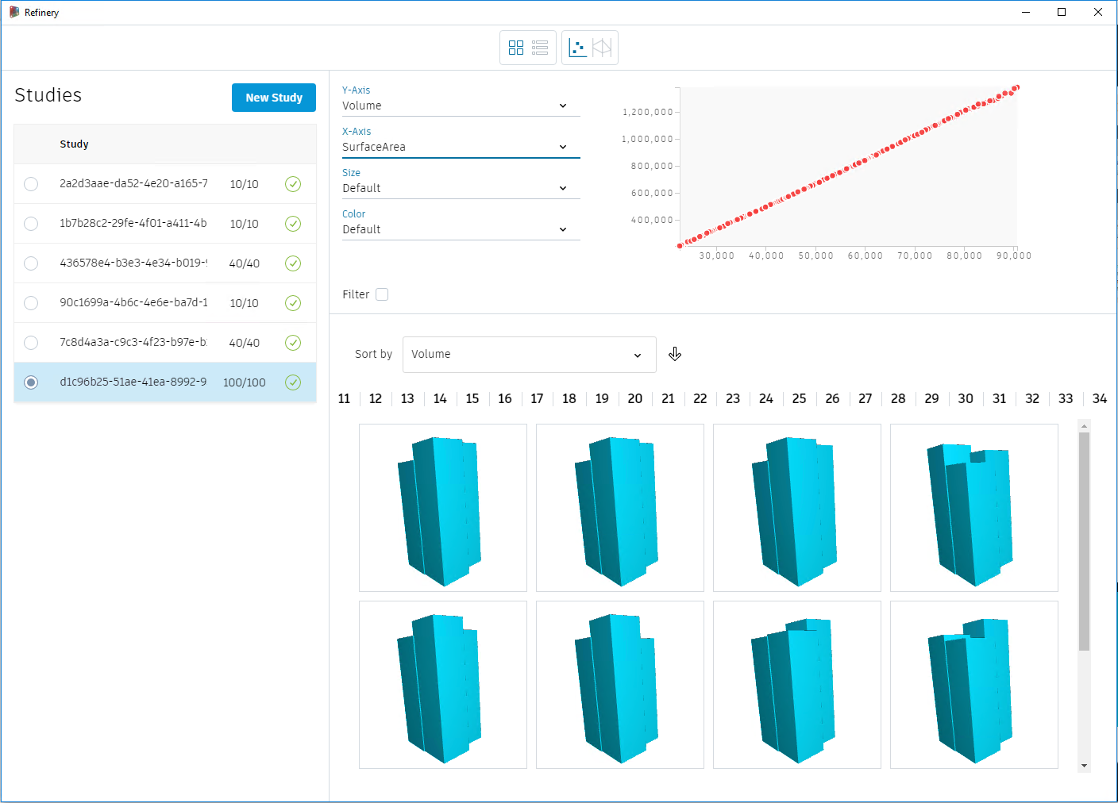
Refinery randomization vs. optimization
40 random runs – 10 sec
100x100 optimization – 4 min
Notes:
Show pareto front with “utopia point”, sped up video of designs coming and going, evolving to better options
Explain pareto front – surface area and volume example
Compare random run graph to optimized run (thinner front line)
Sort for max volume and then min surface area

Slide 68
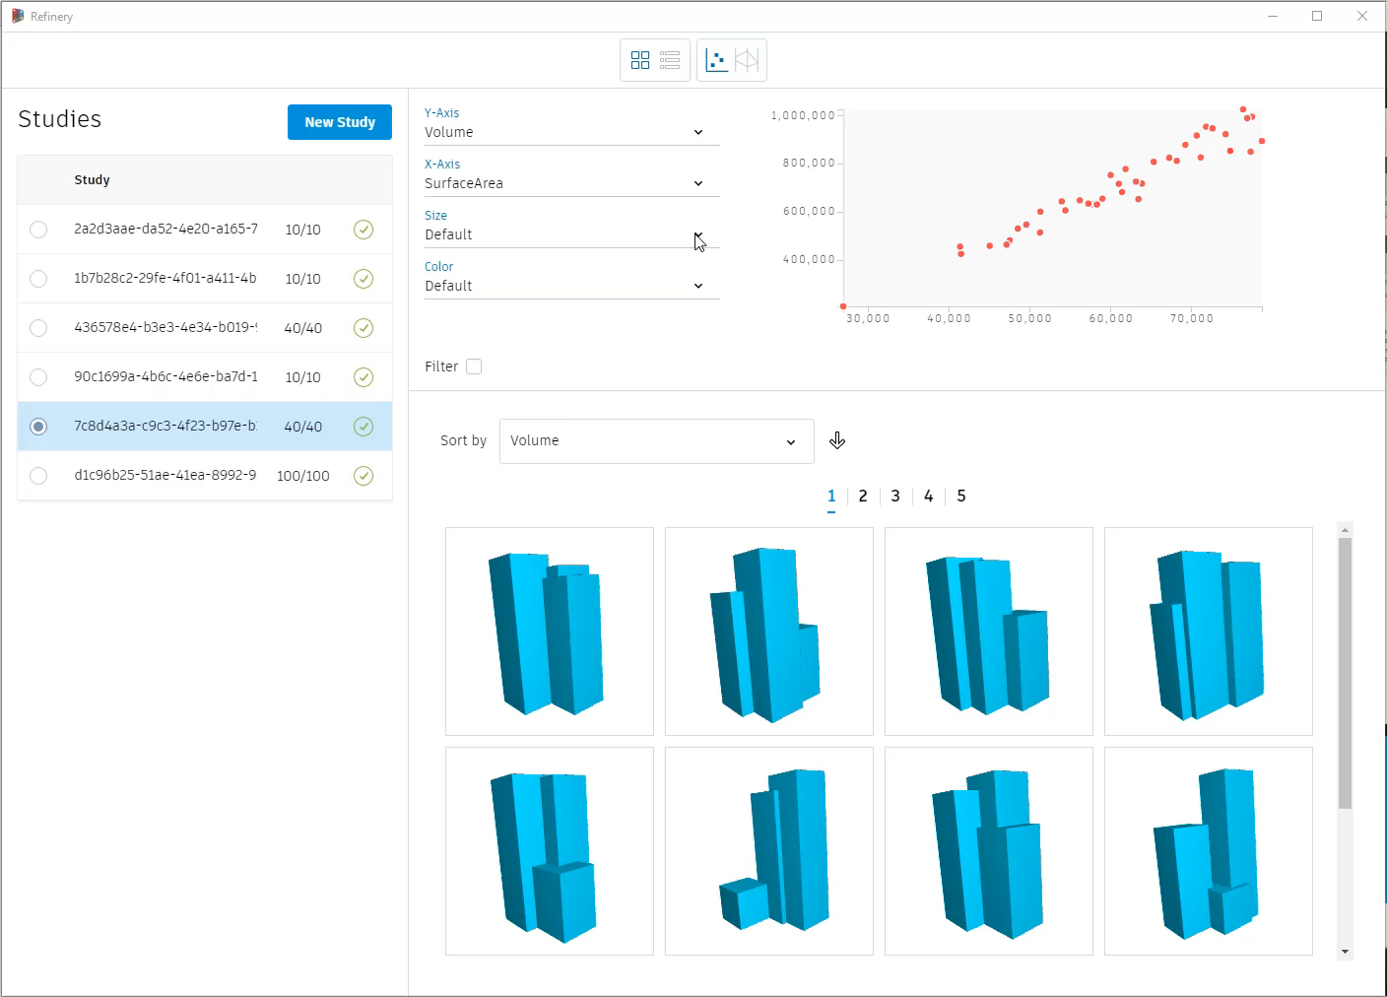
Refinery Explore UI

Slide 70
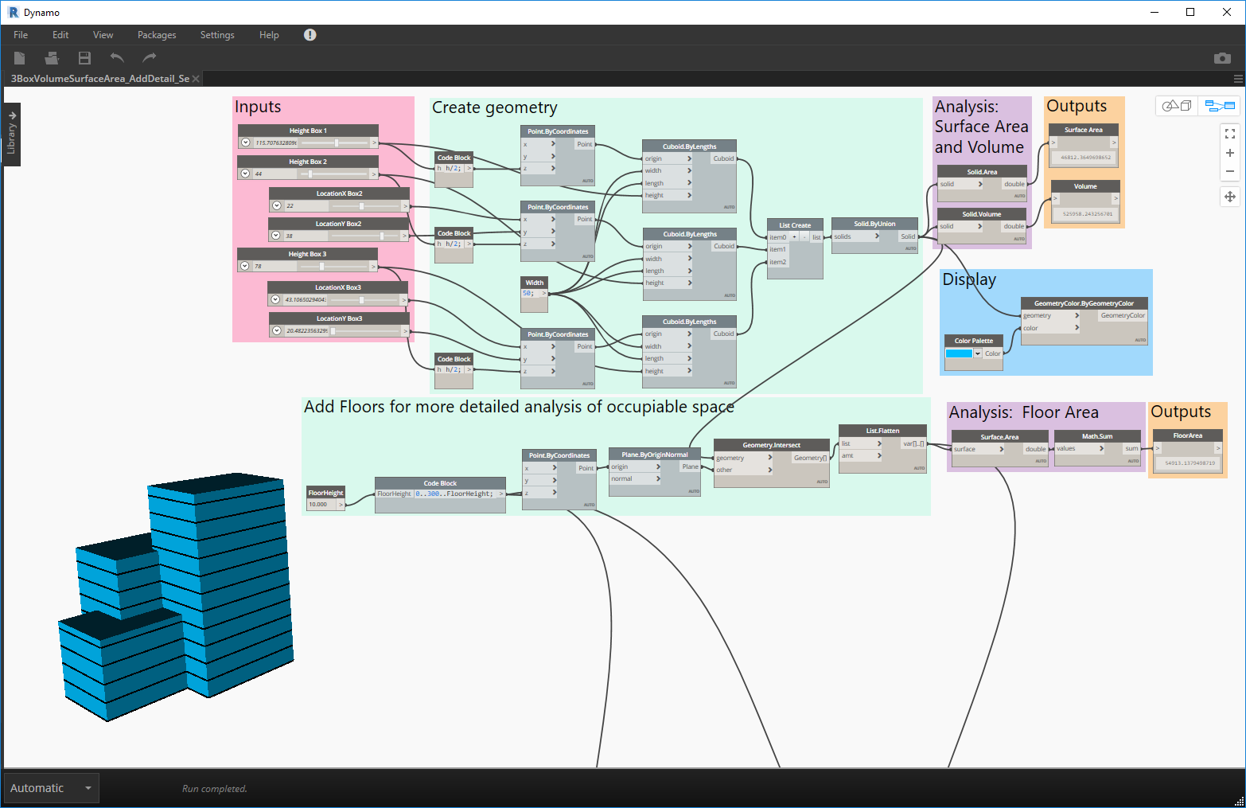
Notes:
Types of inputs

Slide 71


Slide 72
2D Hill Climbing Let’s go back a step and focus on goal-setting and how to make evaluators
Example 2 (or 0)
Notes:
Be sure to always include a title and a subhead

Slide 73

Goals
What are we solving for?
Find Maximum Height Z for Point P
Variable Inputs:
Curve C
Point P
Goals:
Maximum Height Z
Max Height Z
Curve C
Point P

Slide 74
Goals
What are we solving for?
Find Maximum Height Z for Point P
z = f(c,p)
maximize z
Variable Inputs:
Curve C
Point P
Objective Function:
z = f(c,p)
Find maximum height
f(c,p) =
Projected Point P’ = P.Project(C)
Height Z = P’.z
x = P.x
Max Height Z
Curve C
Point P

Slide 75
EVALUATORS
Max Height Z
Curve C
INPUTS
GEOMETRY
Projected Point P’ = P.Project(C)
Height Z = P’.z
x = P.x
Point P

Slide 76

Measuring goals
EVALUATORS
Notes:
f(c,p) =
Projected Point P’ = P.Project(C)
Height Z = P’.z
x = P.x

Slide 78
Refinery Methods
TYPES
RANDOMIZE
OPTIMIZE
INPUTS
DESIGN SPACE
OUTCOME
Parameter 1
5 DESIGNS
# defined by user
Parameter 2
Parameter 1
Parameter 2
generation 1
population of 3
Parameter 1
3 x 6 = 18 DESIGNS
user defines population size and number of generations
generation 2
population of 3
Parameter 2
Parameter 1
…
generation 6
population of 3
Parameter 2
Notes:
Deterministic methods
Save · an individual option by editing input values on Refinery
Cross-product · to survey the whole design space
Randomize · to obtain random input configurations
Like this · to apply slight variations to your current input configuration
intelligence methods
Optimize · a set of output parameters of a parametric model to improve the performance of your design

Slide 79

Refinery Methods
TYPES
RANDOMIZE
INPUTS
Parameter 1
5 DESIGNS
# defined by user
Parameter 2
Parameter 1
Parameter 2

Slide 80


Slide 81


Slide 82


Slide 83

MORE INPUTS!

Slide 84

Refinery Methods
TYPES
OPTIMIZE
INPUTS
generation 1
population of 3
Parameter 1
3 x 6 = 18 DESIGNS
user defines population size and number of generations
generation 2
population of 3
Parameter 2
Parameter 1
…
generation 6
population of 3
Parameter 2

Slide 85


Slide 86

Refinery Methods
TYPES
OPTIMIZE
INPUTS
generation 1
population of 3
Parameter 1
3 x 6 = 18 DESIGNS
user defines population size and number of generations
generation 2
population of 3
Parameter 2
Parameter 1
…
generation 6
population of 3
Parameter 2

Slide 87


Slide 88

Measuring goals – DesignScript
Find Maximum Height Z for Point P
z = f(c,p)
maximize z
Variable Inputs:
Curve C
Point P
Objective Function:
z = f(c,p)
Find maximum height
f(c,p) =
Projected Point P’ = P.Project(C)
Height Z = P’.z
x = P.x

Slide 89

Measuring goal - Python

Slide 90


Slide 91


Slide 92


Slide 93






Local Solver – More Advanced Evaluator
Global Solver vs Local Solver
Python loop to move points closer to local peaks
Position y = f(x) position function we have been using
Tangent dy = f’(x)dx f’(x) is the derivative of x
Slope/Velocity v = dy/dx slope of tangent line represents ‘velocity’
Acceleration dv = f’’(x) change in slope of tan line is ‘acceleration’
f’(x) = (f(x + h/2) - f(x - h/2))
h

Slide 94

Newton’s Method in Python

Slide 95


Slide 96


Slide 97


Slide 98


Slide 99
Building Massing
Example 3
Notes:
Be sure to always include a title and a subhead

Slide 100

Goals
What are we solving for?
Retail and office distribution and configuration for a building on an urban site.
Variable Inputs:
1. Ratio retail to office
2. Program block size
3. Program block rotation
Goals:
1. Minimize zoning envelop overlap
2. Minimize cost
3. Maximize total value per year

Slide 101

INPUTS
GEOMETRY
EVALUATORS
INTEGRATORS

Slide 102


Slide 103


Slide 104


Slide 105


Slide 106


Slide 107
Metric Comparison
Building Massing Study
Metric | Retail | Office
Cost Per SF | $180 | $300
Floor to Floor Height | 14 | 15
Revenue/SF/YR | $35 | $25
Elevation Bonus (0-50’) | 1 | 1
Elevation Bonus 51-150’ | 0.25 | 1.2
Elevation Bonus 151’+ | 0.1 | 1.5
Orientation Bonus 0-20 | n/a | 1
Orientation Bonus 21-40 | n/a | 1.2
Orientation Bonus 41+ | n/a | 1.5

Slide 108


Slide 111


Slide 112


Slide 113

Refinery
40 Random Runs
Least Value/Yr
Notes:
Lots of retail high up, less office means less value per year

Slide 114

Refinery
40 Random Runs
Most Value/Yr
Notes:
Retail on bottom floors, more office for more value per year

Slide 115

Refinery
40 Random Runs
Lowest Cost
Notes:
More retail, less expensive to build

Slide 116

Refinery
40 Random Runs
Highest Cost
Notes:
More office, more expensive to build

Slide 117

Refinery
40 Random Runs
Medium Cost
Medium Value

Slide 118

Refinery
40 Random Runs
Medium Cost
Medium Value
Lowest volume
Outside zoning

Slide 119


Slide 120

Refinery
20x50 Optimization
Medium Cost
Medium Value
Lowest volume
Outside zoning
Notes:
More similar options, fill up zoning boundary (?)

Slide 121
Adding New Evaluator to Building Massing
Example 3.5
Notes:
Be sure to always include a title and a subhead

Slide 122


Stealthy RoofScapes!
UK Dynamo User Group’s Dynamo + Generative Design Hackathon 2019
Bogdan Davydov
Wiktor Kidziak
Thomas Corrie

Slide 123

Stealthy RoofScapes!
UK Dynamo User Group’s Dynamo + Generative Design Hackathon 2019

Slide 124

Stealthy RoofScapes!
UK Dynamo User Group’s Dynamo + Generative Design Hackathon 2019

Slide 125

Stealthy RoofScapes!

Slide 126

Re-using and Re-applying Evaluators
Box Select
CTRL-C to Copy

Slide 127

In Same Dynamo/Revit Session
Open Building Massing RVT/DYN
CTRL-V to Paste

Slide 128

Inputs – Office Block Geometry

Slide 129

Inputs – Sample Points

Slide 130


Slide 131


Slide 132


Slide 133

StealthyRoofScape Evaluator On Building Massing

Slide 134
Solar Analysis
Example 4
Notes:
Be sure to always include a title and a subhead

Slide 135


Slide 136


Slide 137


Slide 138


Slide 139


Slide 140
Office Layout
Example 5
Notes:
Be sure to always include a title and a subhead

Slide 141

Goals
What are we solving for?
Look at desk layouts that gives us the most desks but also the most private desks while maximizing desk area per person and minimizing unutilized space.
Variable Inputs:
Edge to start layout
Desk rotation
Position on room surface
Desk clearance
End offset
Goals:
Maximize number of desks
Maximize desk area per person
Maximize space utilization
Maximize number of private desks

Slide 142

INPUTS
GEOMETRY
EVALUATORS
INTEGRATORS

Slide 143


Slide 144


Slide 145


Slide 146


Slide 147


Slide 148

How far is it from desk to desk?
How many desks are less than 12’ away from each other?
How many desks have less than 3 desks within 12’?

Slide 149


Refinery
40 Random runs
Most Private Desks
Most Desks

Slide 150


Slide 151


Refinery
10x20 Optimization
Most Private Desks
Most Desks

Slide 152


Slide 153


Slide 154
Refinery Primer Samples
Example 7 – Overflow Samples
Notes:
Be sure to always include a title and a subhead

Slide 155
Autodesk MaRS Office
Example 10 – Overflow Samples
Notes:
Be sure to always include a title and a subhead

Slide 156
Tiling
Example 11 – Overflow Samples
Notes:
Be sure to always include a title and a subhead

Slide 157
Refinery Beta Samples
Example 12 – Overflow Samples
Notes:
Be sure to always include a title and a subhead

Slide 158
A SPECIAL THANKS TO:

Slide 159
REMINDER Speaker and Session Feedback is Appreciated
Go to Sessions
Select this Session
Select Session Rating

Slide 160
Reference Links
https://refineryprimer.dynamobim.org/
https://refineryprimer.dynamobim.org/02-getting-started/02-01_anatomy-of-a-good-generative-design-process
https://refineryprimer.dynamobim.org/06-using-revit-alongside-refinery/06-03_detailed-example-workflow
https://github.com/DynamoDS/RefineryPrimer
https://www.keanw.com/
https://www.keanw.com/2019/06/project-rediscover-is-now-available-for-download.html
https://dynamobim.org/math-transit/ 2d point plotting
https://scipy-lectures.org/advanced/mathematical_optimization/index.html
https://en.wikipedia.org/wiki/Numerical_differentiation
https://aroberge.blogspot.com/2005/04/computing-derivatives-using-python.html

Slide 161
REMINDER Session materials are available on the Conference App
Session 1.5 How to Train Your Model with Project Refinery
Matt Jezyk

Slide 162
Visit me at the Speaker Lounge
I will be at the Speaker Lounge outside the Exhibition Hall for further conversations. Please join me there at this time:
Thursday 18 (06:10 PM - 08:10 PM)
Or at the Exhibition Networking Function that evening

Slide 163
Questions?
How to Train Your Model with Project Refinery
Matt Jezyk, Senior Staff Software Engineer, Tesla
Formerly Senior Engineering Manager
Autodesk AEC Generative Design
@MattJezyk

